Slide 1
The US Constitution

Slide 2
I. Philadelphia Convention, 1787
On February 21, 1787, the Continental Congress resolved that: ... it is expedient that on the second Monday in May next a Convention of delegates who shall have been appointed by the several States be held at Philladelphia for the sole and express purpose of revising the Articles of Confederation...
55 delegates attended, only 39 signed the final document
12 of 13 states sent delegates(not Rhode Island)

Slide 3
II. Issues
Fear of national power
Representation in legislature
Small states vs. Large
Sectionalism, North vs. South vs. West
Foreign Dangers on continent and abroad
Slavery

Slide 4
III. Proposals
Virginia Plan (endorsed by large states)
Madison – scrapped Articles
3 branches
bicameral legislature: representation based on population (proportional); veto power over states
powerful executive, judiciary – both could veto Congress
New Jersey Plan (endorsed by small states)
Maintained unicameral legislature of Articles – one vote per state
Congress could tax, regulate trade, use force against states
Plural presidency

Slide 5
III. Compromise
Representation in Congress (Big States vs. Small States)
Great Compromise
House = proportional representation, directly elected
Senate = equal representation, indirectly elected
Slavery (North vs. South)
Three-Fifths Compromise; import ban after 20 years
Election of President (Direct or by Congress)
Electoral College

Slide 6
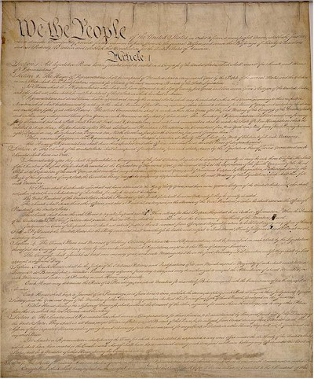
IV. The Principles of the United States Constitution

Slide 7
A. Popular Sovereignty
The people hold the ultimate authority
A representative democracy lets the people elect leaders to make decisions for them.

Slide 8
B. Limited Government
Framers wanted to guard against tyranny
Government is limited to the power given in the Constitution.
The Constitution tells how leaders who overstep their power can be removed
(Bill of Rights)

Slide 9
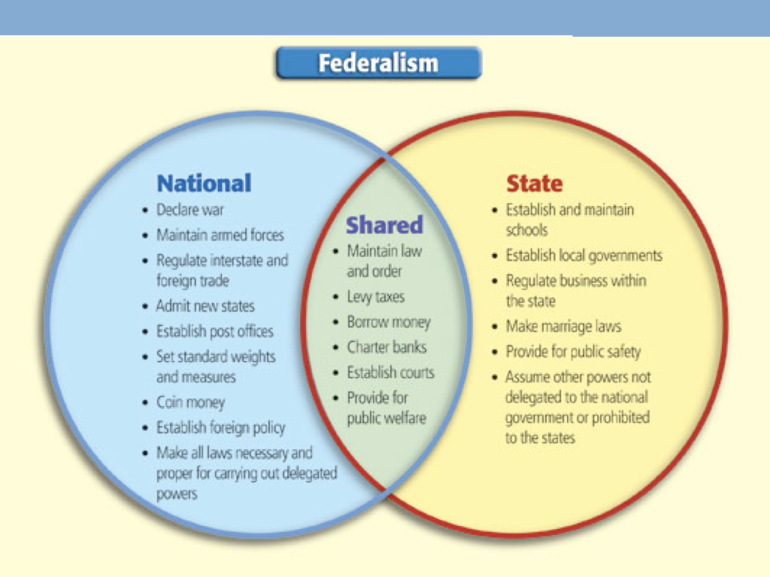
C. Federalism
The division of power between National and State Governments
Federal Supremacy

Slide 10
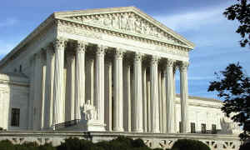
D. Separation of Powers
No branch holds “too much” power
Legislative branch makes the laws
Executive branch carries out the laws
Judicial branch interprets the laws

Slide 11
Legislative Branch
Senate and House of Representatives
Make our laws
Appropriate Money
Regulate Immigration
Establish Post Offices and Roads
Regulate Interstate Commerce and Transportation
Declare War

Slide 12
Executive Branch
The President of the United States
Wears many hats: Chief Executive, Chief of State, Chief Legislator, Commander in Chief, etc.
Executive Departments
Cabinet

Slide 13
Judicial Branch
Supreme Court and other Federal Courts
Preserve and protect the rights guaranteed by the Constitution
Judicial Review – can declare acts by other branched unconstitutional (Marbury v. Madison, 1803)

Slide 14
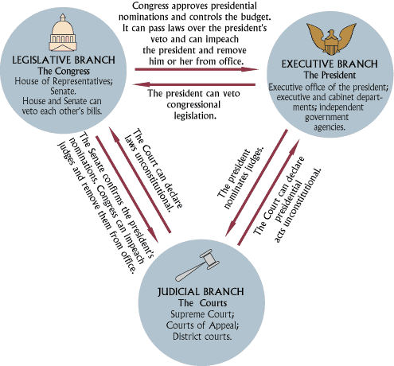
E. Checks and Balances

Slide 15
Executive Checks
Propose laws to Congress
Veto laws made by Congress
Negotiate foreign treaties
Appoint federal judges
Grant pardons to federal offenders

Slide 16
Legislative Checks
Override president’s veto
Ratify treaties
Confirm executive appointments
Impeach federal officers and judges
Create and dissolve lower federal courts

Slide 17
Judicial Checks
Declare executive acts unconstitutional
Declare laws unconstitutional
Declare acts of Congress unconstitutional
The Supreme Court holds the final check

Slide 18
F. Flexibility
Elastic Clause
The Congress shall have Power ... To make all Laws which shall be necessary and proper for carrying into Execution the foregoing Powers, and all other Powers vested by this Constitution in the Government of the United States, or in any Department or Officer thereof.
Strict vs. Loose Construction (interpretation)
Unwritten Constitution
Amendment Process...

Slide 19
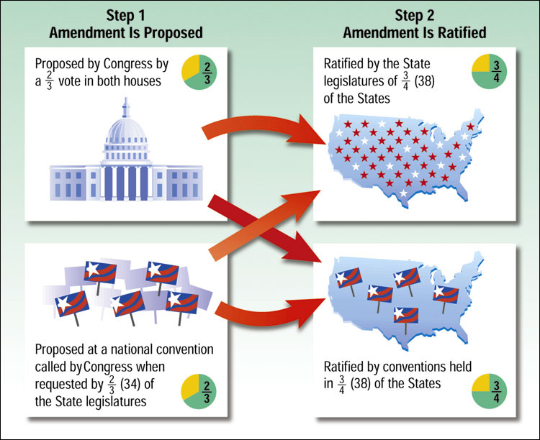
Formal Amendment Process
1
3
Chapter 3, Section 2

Slide 20
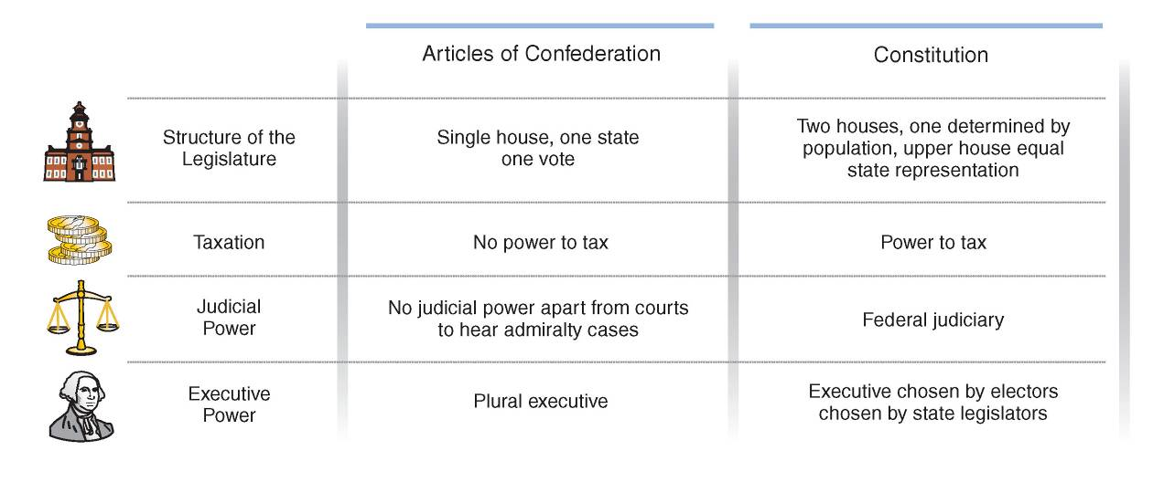
V. The Constitution “fixed” the Articles

Slide 21
VI. The Ratification Controversy
Ratification was closely contested nationally during 1787 and 1788
Any nine of the thirteen states were sufficient for ratification
But rejection by any of the four most prominent states-Massachusetts, New York, Pennsylvania, or Virginia would have doomed the Constitution

Slide 22
The Federalist Papers
A set of essays, written by Hamilton, James Madison, and John Jay, and published in New York newspapers under the pseudonym Publius.
Argued that the Constitution was necessary to strengthen national government and protect the people.
Federalist #10 (Madison)
Addressed the question of how to guard against "factions,” or groups of citizens, with interests contrary to the rights of others or the interests of the whole community. Madison argued that a strong, big republic would be a better guard against those dangers than smaller republics—for instance, the individual states.

Slide 23
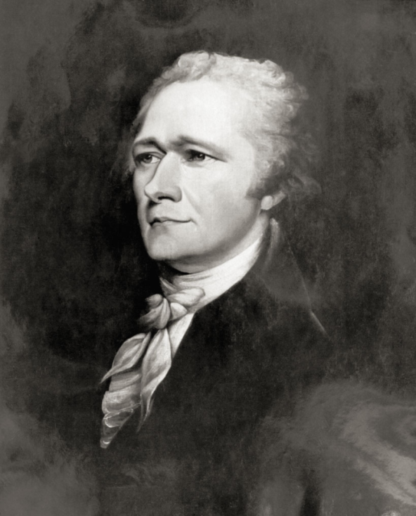
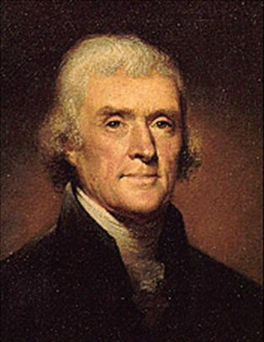
• Antifederalists, fearing a strong central government would limit individuals’ and states’ rights, demanded a Bill of Rights
• Federalists, such as Alexander Hamilton, were against the Bill of Rights, claiming it was unnecessary since all state constitutions already had a bill of rights.
Alexander Hamilton: Opposed the Bill of Rights
Thomas Jefferson: Favored the Bill of Rights

Slide 24
Why the Federalists Won
Many people believed the Articles were a failure
The Federalists were united for the cause, while the Antifeds had many different factions
Feds were well organized
Feds had the support of George Washington
Feds promised to add Bill of Rights, which became first 10 Amendments to Constitution in 1791.

