Slide 1
The Market Revolution

Slide 2
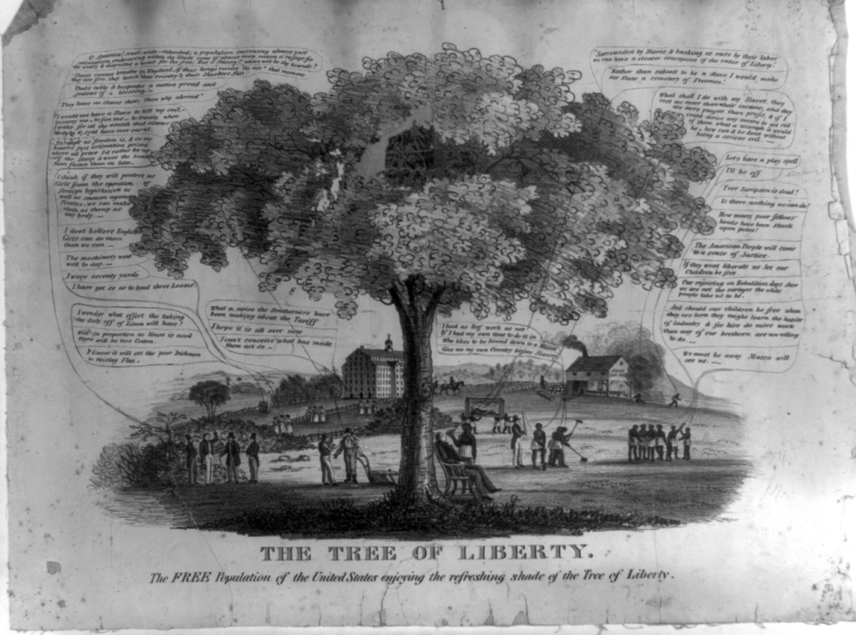
2 Visions of America, A History of the United States
Notes:
Chapter Opener: The Tree of Liberty (page 253)
Text Excerpt: This image, The Tree of Liberty (1846), illustrates the radical differences between the vision of liberty defended by Northern proponents of free labor and that of Southern defenders of slavery. On the right side of the tree, a slaveholder reclining in a chair while fanned by a slave announces, “Surrounded by slaves & basking at ease by their labor we can have a clearer conception of the value of liberty.” On the other side of the tree, the artist has placed two industrious farmers conversing, and young mill women in front of their factory.
Background: The Tree of Liberty is a complex image that contrasts the world of Northern free labor with Southern slavery. Much of the discussion occurring in the image—particularly on the side depicting free labor—focuses on the issue of tariffs and their impact on Northern industry and agriculture. The artist has included a mill, and a group of mill girls. The abolitionist sympathies of the artist are also evident. One of the farmers conversing on the lower left states emphatically that “No! dear as freedom is, & in my heart's just estimation prized above all price I'd rather be myself the slave & wear the bonds than fasten them on him.” On the opposing side, scenes of Southern dissipation and tyranny abound. A slaveholder reclines in a chair while his slave fans him. Another master stands with a whip in hand ready to discipline his bondsmen.
Chapter Connections: The focus of this image is on the radically different economic worlds of the North and the South. Factory work—including the new labor source, mill girls—is prominently featured. Commercial agriculture is contrasted with slave labor. A group of men boast that “O America! vast—wide—extended; a population increasing almost past calculation, embracing within thy limits some of almost every nation; a refuge for the weary & distressed a home for the free.” Immigration provided one source of cheap labor, an essential ingredient of the North's economic prosperity. Although this artist's abolitionist views lead him to cast Northerners as champions of freedom and Southerners as supporters of despotism, Southerners viewed their own system as no less committed to American ideals of freedom. Indeed, one Southerner expressly states his view that the freedom from want that his slaves provide allows him to have an even better understanding of liberty than those in the North.
Discussion Questions:
What symbols of Northern free labor does the artist include?
How is Southern slavery portrayed?

Slide 3
Divergent Paths
Doc D
Due to the “Market Revolution,” the North developed an economy centered on industry, commerce and wage laborers
Thanks to “King Cotton,” the South grew more and more to rely on slave labor to underpin its way of life

Slide 4
Population Density

Slide 5
The Market Revolution
A set of interrelated developments in agriculture, technology, and industry that led to the creation of a more integrated national economy.
Impersonal market forces impelled the maximization of production of agricultural products and manufactured goods and increased consumption.
5 Visions of America, A History of the United States

Slide 6
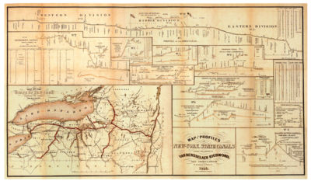
Market Revolution
Doc H. I, J
Increased commercialism and rise of factories
New methods of transportation linked West to manufacturing of the East.
Canals and turnpikes developed
Combination of public and private financing
1853 Map of the Erie Canal

Slide 7
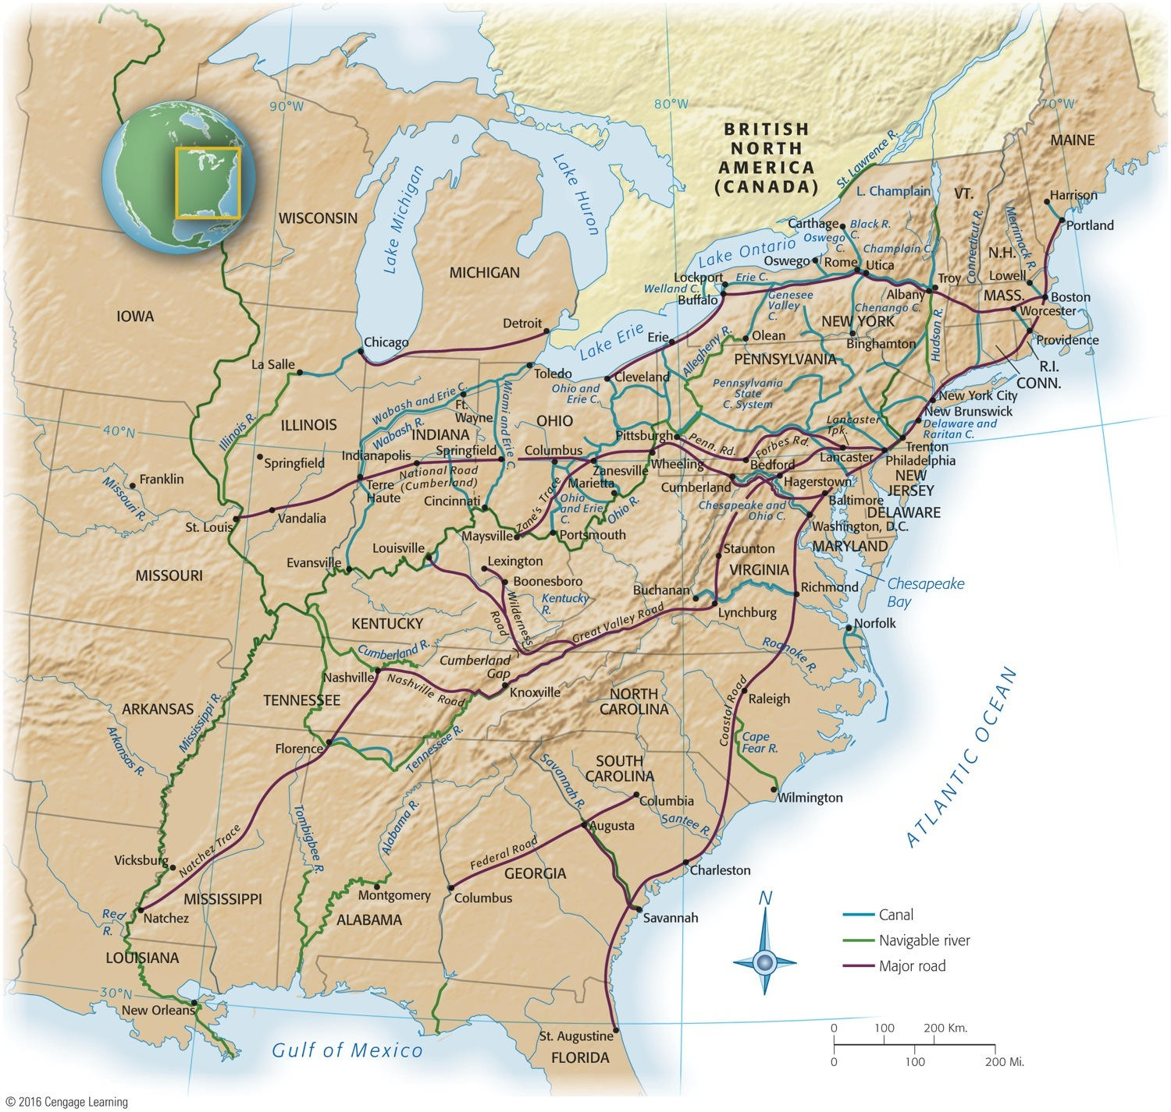
Transportation Revolution

Slide 8
Transportation Revolution
Doc B, E
States chartered private companies to build toll roads
National Road from Virginia to Illinois
Debate over who funds “internal improvements”
Erie Canal – first great engineering project; environmental impact
Begun in 1817, canal stretched 363 miles from Buffalo on Lake Erie, to Hudson River, onto New York harbor

Slide 9
Transportation Revolution
Steamboat contributes to economic growth of Midwest
Upstream travel; Robert Fulton
Development of railroad:
Fast, reliable, cheaper than canals to construct, and not frozen over in winter
Able to go anywhere—it defied terrain and weather
First railroad appeared in 1828 and new lines spread swiftly

Slide 10
Transportation Revolution
Other forms of transportation and communication linked United States and world:
Cyrus Field in 1858:
Called “the greatest wire-puller in history,” stretched a cable from Newfoundland to Ireland
A heavier cable in 1866 permanently linked American and European continents
Donald McKay developed new clipper ships
Sacrificed cargo space for speed, their hour of glory was relatively brief
Eve of Civil War, British steamers won race for maritime ascendancy:
Steadier, roomier, more reliable – thus more profitable
Stagecoaches
Pony Express (1860)
Carried mail speedily the 2,000 miles from St. Joseph, Missouri to Sacramento, California; ten day trip

Slide 11
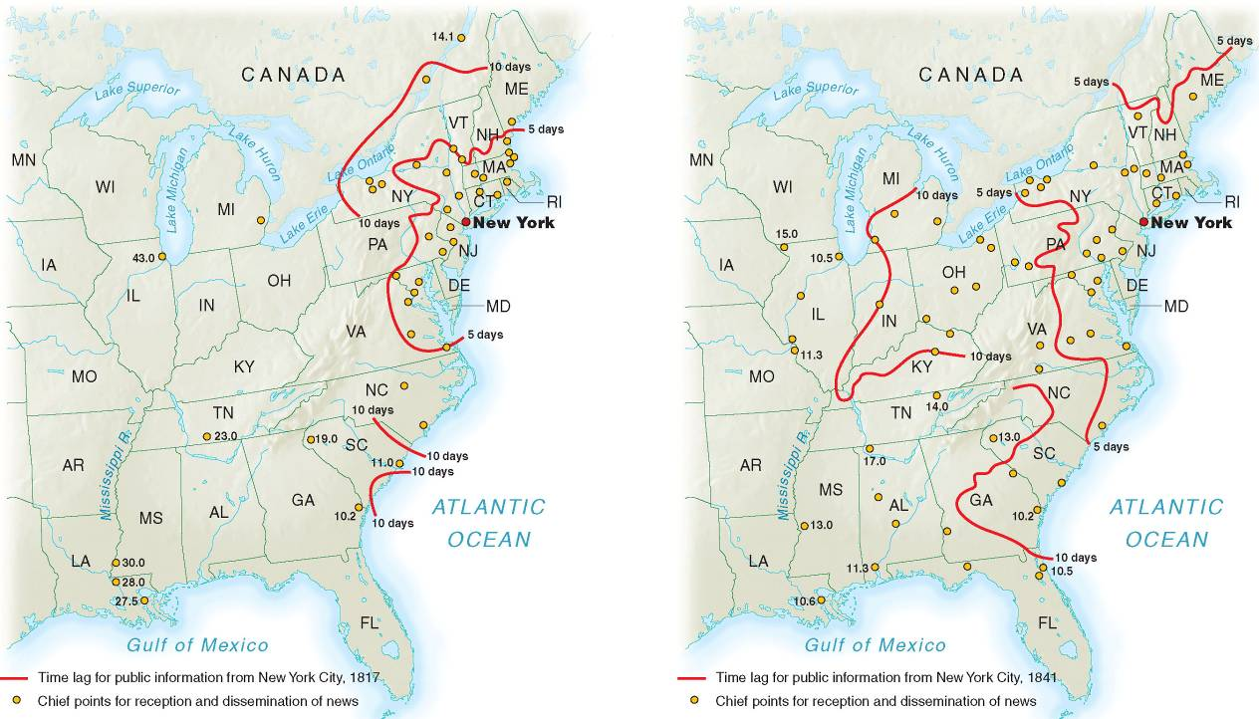
Improvements in Communication
11 Visions of America, A History of the United States
Notes:
9.3 Time Lag for News 1800–1841
Improvements in communication technology and transportation dramatically reduced the time it took for news to travel from the coastal cities to the interior cities.

Slide 12
American Industry
Two great changes:
Growth and mechanization of industry
Division of labor
Interchangeable parts
Factory System
Improved technology
“Waltham Plan” – factories and dorms
Expansion and integration of markets

Slide 13
Mechanization
British inventors in 1750s perfected series of machines for mass production of textiles:
Harnessed steam to usher in modern factory system of Industrial Revolution
Spectacular transformation in agricultural production
As well as methods of transportation and communication
Factory system slowly spread from Britain, “the world's workshop”
Samuel Slater— “Father of Factory System”
Why was United States slow to industrialize?
Land was cheap
Labor was scarce
Money for capital investment was scarce

Slide 14
Manufacturing
Doc A, F
As factory system flourished, it embraced other industries.
Contribution of Whitney's interchangeable parts to manufacture of firearms:
Basis of mass-production, assembly-line methods
Sewing machine:
Invented by Elias Howe in 1846; Perfected by Isaac Singer
Strong boost to northern industrialization
Moved sewing from private homes to factory
Samuel F. B. Morse:
Invented telegraph & secured $30,000 from Congress to experiment with “talking wires”
Other inventions:
McCormick's reaper, Colt's firearms, Charles Goodyear's vulcanized rubber
Each new invention stimulated still more imaginative inventions:
Decade ending in 1800: only 306 patents registered
Decade ending in 1860: 28,000 patents registered
Key changes in form and legal status of business organizations:
Principle of limited liability aided concentration of capital

Slide 15
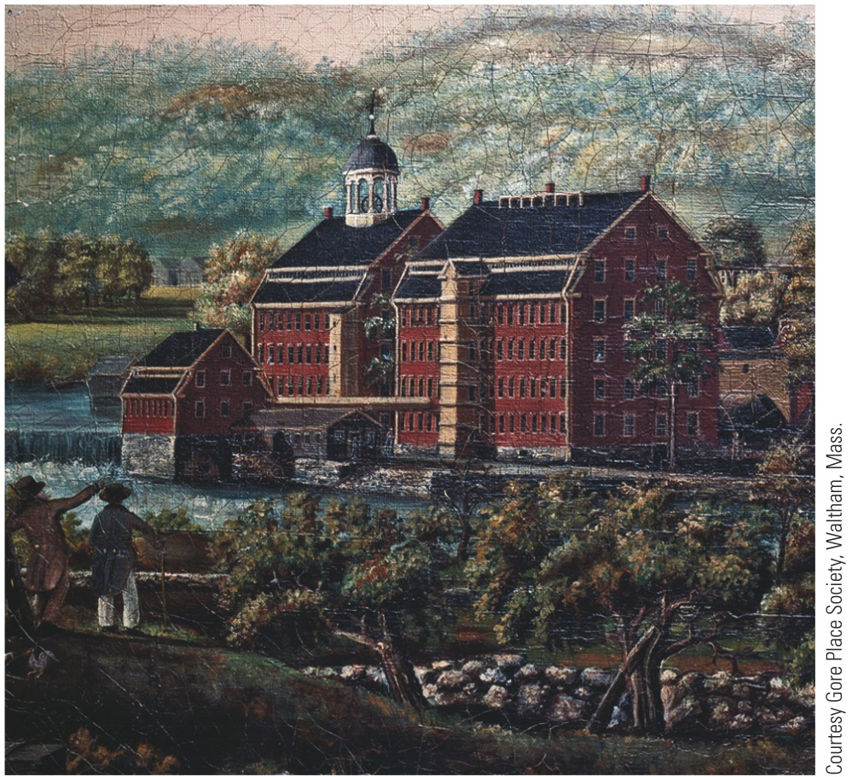
p290
Notes:
Francis Cabot Lowell’s Mill, Waltham, Massachusetts, 1826, and Cotton Industry; Carding,
Drawing, and Roving; Engraving, 1835 Built in 1814, Lowell’s mill (left) was a marvel of
manufacturing efficiency. It combined all phases of production, including spinning and weaving,
under one roof. The mill’s labor force (right) was composed primarily of young women from the
local farming communities.

Slide 16
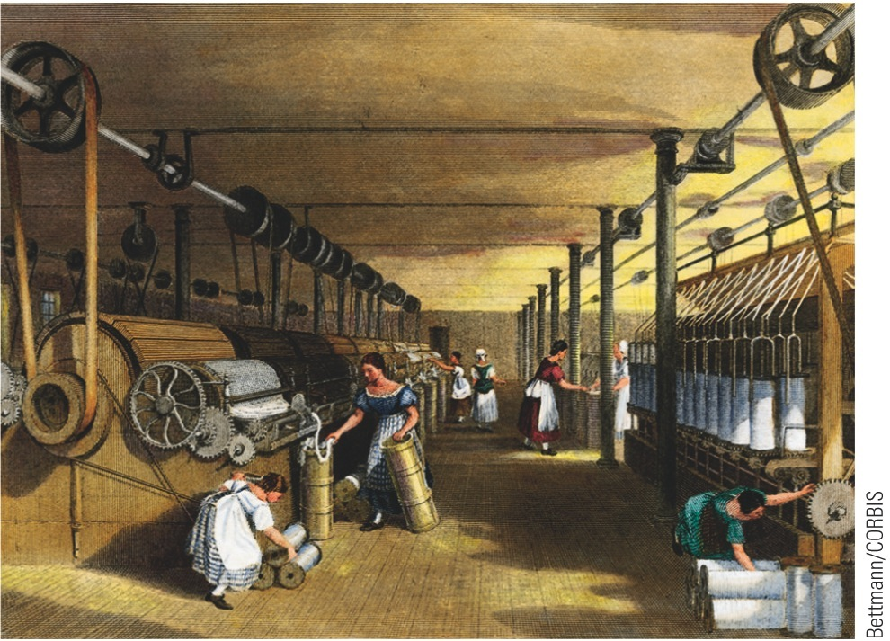
p290
Notes:
Francis Cabot Lowell’s Mill, Waltham, Massachusetts, 1826, and Cotton Industry; Carding,
Drawing, and Roving; Engraving, 1835 Built in 1814, Lowell’s mill (left) was a marvel of
manufacturing efficiency. It combined all phases of production, including spinning and weaving,
under one roof. The mill’s labor force (right) was composed primarily of young women from the
local farming communities.

Slide 17
From Artisans to Workers
Doc C
Artisan Production
A system of manufacturing goods, built around apprenticeship, that defined the preindustrial economy.
The apprentice learned a trade under the guidance of an artisan who often housed, clothed, and fed the apprentice.
Industrial Production
“wage slavery”
Outside the home
Unskilled & Depersonalized
Child labor
17 Visions of America, A History of the United States

Slide 18
Impact on Labor
Workers challenged the transition from artisan to wage laborer
Unions develop, though technically illegal
“Labor Theory of Value”
Overproduction leads to layoffs – “business cycle”
Ex. Panic of 1819
1836 Song Lyrics Sung by Protesting Workers at Lowell
Oh! isn't it a pity, such a pretty girl as I Should be sent to the factory to pine away and die? Oh! I cannot be a slave, I will not be a slave, For I'm so fond of liberty, That I cannot be a slave.

Slide 19
Labor
Labor's effort to organize:
Some 300,000 trade unionists by 1830
Declined as result of severe depression, 1837
Won promising legal victory in 1842 in Commonwealth v. Hunt
Mass. Supreme Court ruled unions not illegal conspiracies, provided methods were “honorable and peaceful”
Case did not legalize right to strike

Slide 20
Women and the Economy
Women became part of factory production:
Factories undermined work of women in homes
Factory jobs promised greater economic independence for women
And means to buy manufactured products of new market economy
Factory jobs were still unusual for women:
Few opportunities to be economically self-supporting (mainly nursing, domestic services, and teaching)
Teaching profession became “feminized” as men left for other opportunities
Household economy
One white family in ten employed poor white, immigrant, or black women
10% of white women worked outside home
20% of all women employed at some time before marriage
Vast majority of working women single
Upon marriage, left job to become wives and mothers, without wages

Slide 21
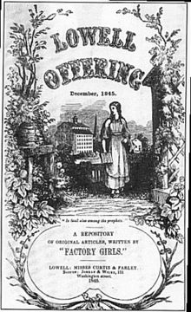
Lowell Mills
Young, unmarried white women moved to Lowell to work, live in boarding house
Owners enforced strict curfews, church attendance and banned alcoholic beverages
In 1840s, replaced by Irish immigrants

Slide 22
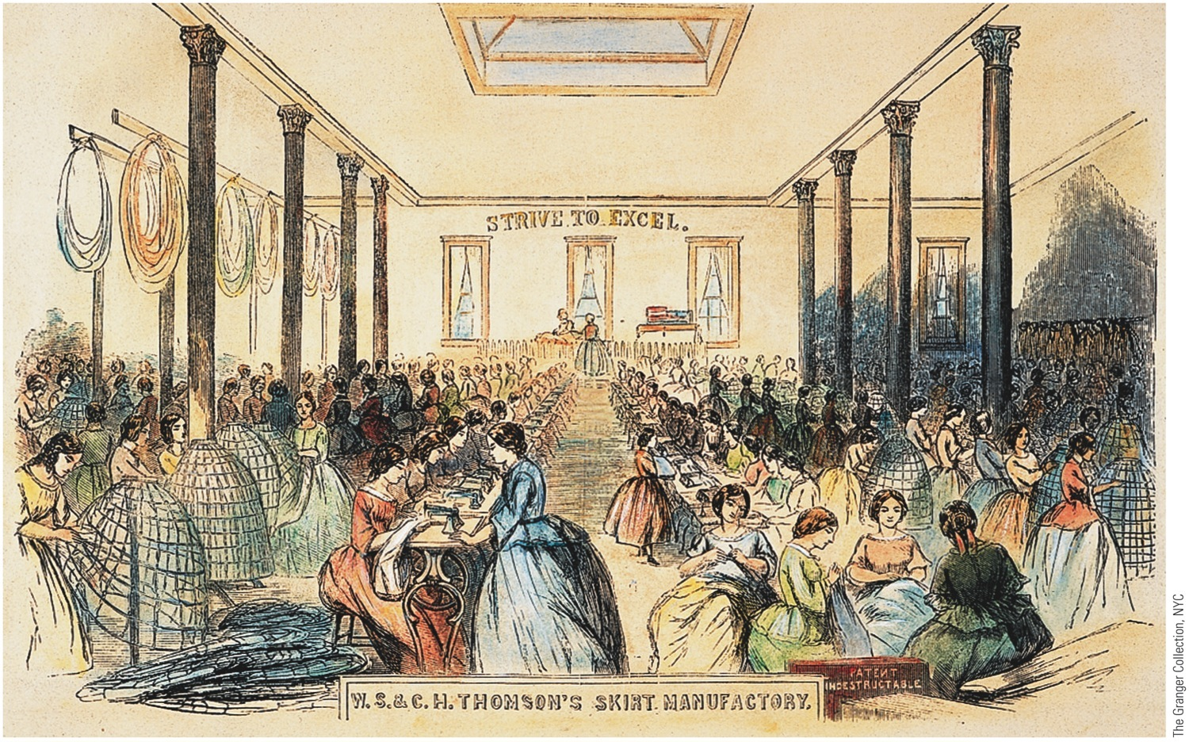
p295
Notes:
The Sewing Floor of Thompson’s Skirt Factory, 1859 The burgeoning textile industry provided
employment for thousands of women in antebellum America—and also produced the clothes that
women wore. This view of a New York City shop in 1859 illustrates the transition from hand-sewing
(on the right) to machine-stitching (on the left). It also vividly illustrates the contrast between the kinds
of “sewing circles” in which women had traditionally sought companionship to the impersonal mass production
line of the modern manufacturing plant. Note especially the stark exhortation on the
wall: “Strive to Excel.”

Slide 23
Women and the Economy
Cult of domesticity:
Widespread cultural creed that glorified customary functions of homemaker
Married women commanded moral power and increasingly made decisions that altered character of family itself
Women's changing roles:
Industrial Revolution changed life in home of nineteenth-century: traditional “women's sphere”

Slide 24
Growth of Cities
1790 only two American cities that could boast populations of 20,000—Philadelphia, New York
1860 there were 43 and 300 claimed over 5,000
Cities grew along rivers as mill owners exploited water power
E.g., Hartford
Western commercial cities grew where goods were transferred from one mode of transport to another
E.g., Pittsburgh
Old Atlantic seaports remained important for foreign commerce and as financial centers
E.g., New York City
Pittsburgh c.1900

Slide 25
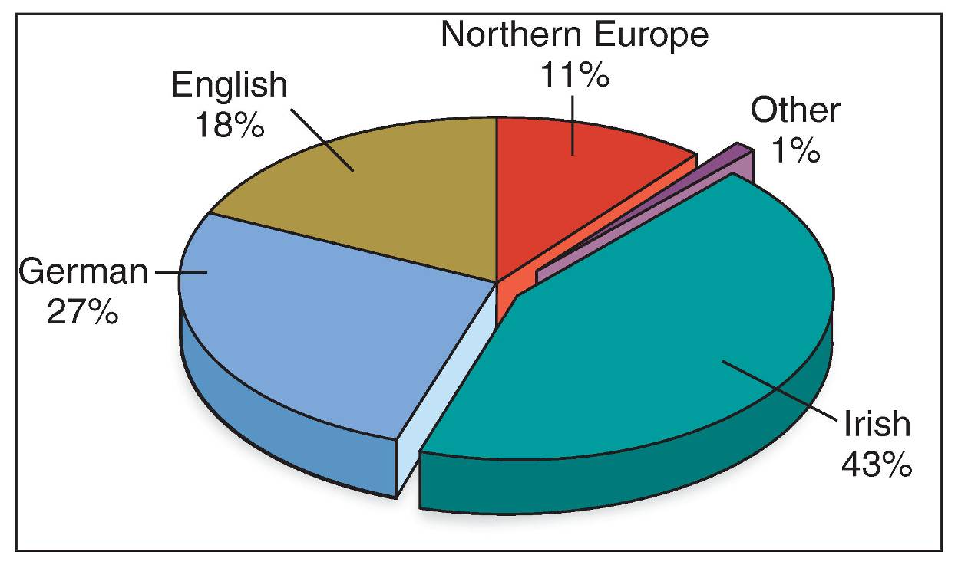
Immigration Trends
Doc G
25 Visions of America, A History of the United States
Notes:
Image 9.9: Sources of European Immigration
Immigrants from Germany and Ireland changed the population mix in much of the nation. The influx of Catholic immigrants in particular resulted in tensions with Protestants.

Slide 26
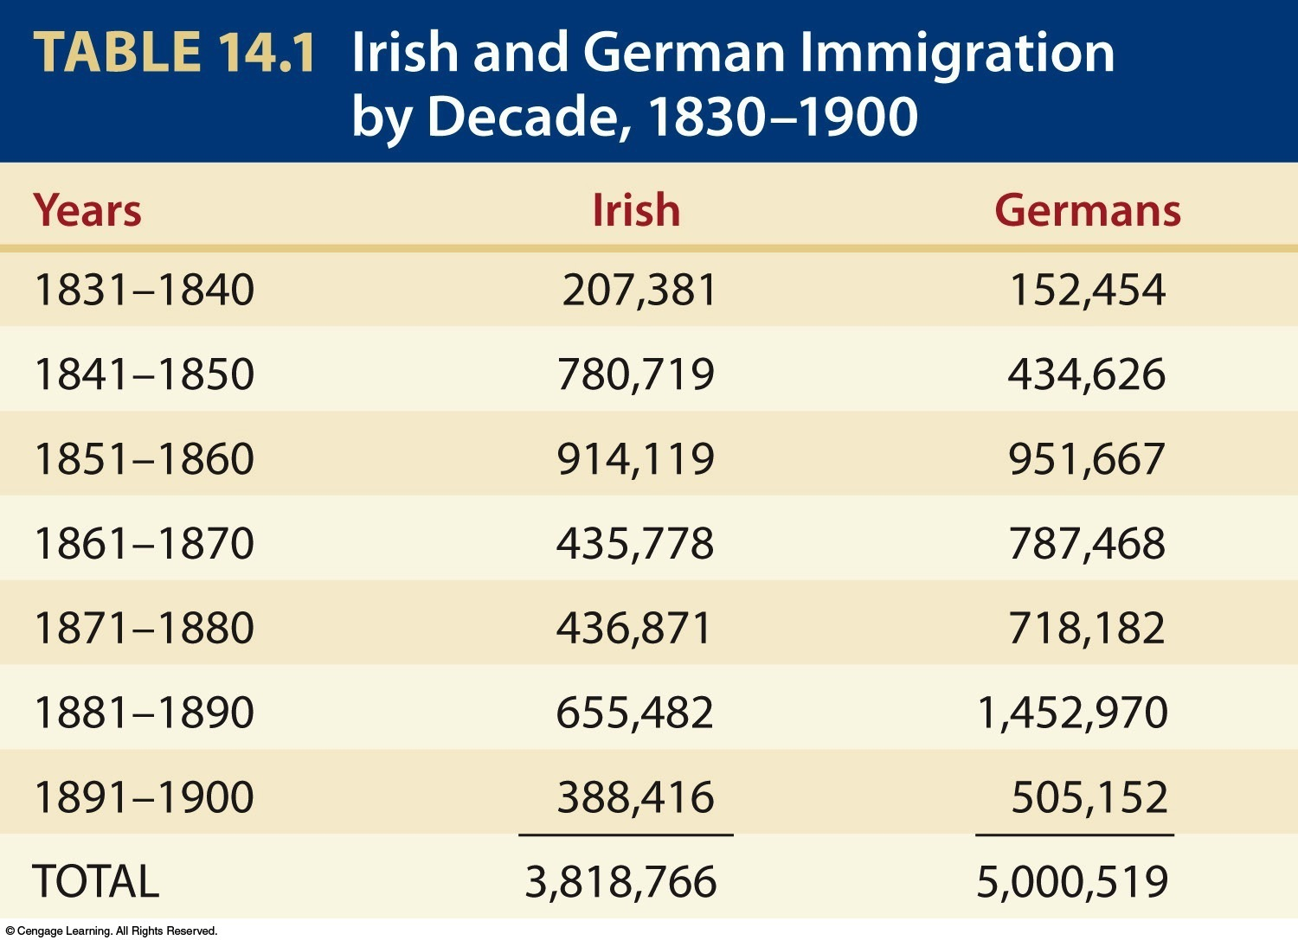
Table 14-1 p281

Slide 27
Immigration
High birthrate accounted for biggest increase in population, but immigration also helped:
By 1830s immigration was 60,000 a year
Influx tripled in 1840s and then quadrupled in the 1850s
During 1840s and 1850s, >1.5 million Irish, and nearly as many Germans came
Why did they come?
Because Europe seemed to be running out of room, had “surplus people”
Majority headed for “land of freedom and opportunity”
New transoceanic steamships allowed immigrants to move speedily and cheaply
United States received far more diverse array of immigrants than other countries
U.S.A. received immigrants from dozens of different nations
Nativism – discrimination against immigrants
Anti-Irish and Anti-Catholic sentiment ran rampant
Know Nothing Party

Slide 28
Changing Social Order
New Industrial Order created distinct social classes
Wealthy increasingly set themselves apart
Middle Class developed – characterization of “self-made man”
Urban poor congregated in separate areas, sought solace in alcohol
Government policies facilitated the accumulation of wealth
John Jacob Astor
Dogfight at Kit Burns

Slide 29
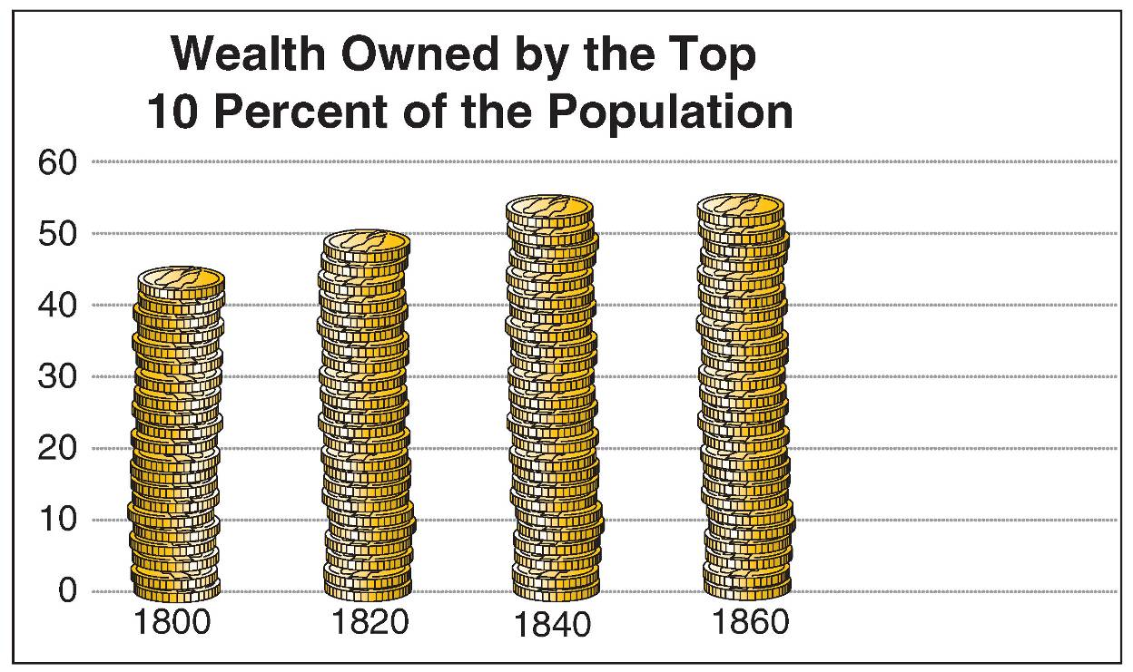
29 Visions of America, A History of the United States
Notes:
9.6 Wealth Stratification
As the nation’s wealth grew during the first half of the nineteenth century, it became more concentrated in fewer hands. The rich controlled an even larger percentage of the nation’s wealth mid-century.

Slide 30
The Market Revolution (Summary)
Market Revolution:
Transformed subsistence economy of scattered farms and tiny workshops into national network of industry and commerce.
Greater mechanization and robust market-oriented economy raised new legal questions:
How tightly should patents protect inventions?
Should government regulate monopolies?
Who should own technologies and networks?
Chief Justice John Marshall's Court protected contract rights by requiring states to grant irrevocable charters

Slide 31
The Market Revolution
Monopolies easily developed and new companies found it difficult to break into markets
Chief Justice Roger Taney argued “rights of the community” outweighed exclusive corporate rights:
His decision encouraged greater competition
So did passage of more liberal state incorporation laws
Self-sufficient households of earlier were transformed:
Now families scattered to work for wages in factories
Or planted just a few crops for sale at market
Used money to buy goods made by strangers in far-off factories

Slide 32
The Market Revolution
Store-bought products replaced homemade products
Changed division of labor and status in household
Traditional women's work rendered superfluous and devalued
Home grew into place of refuge from world of work that increasingly became special and separate sphere of women
Revolutionary advances in manufacturing and transportation brought increased prosperity:
Widened gulf between rich and poor
New examples of colossal economic success
John Jacob Astor left estate of $30 million in 1848

Slide 33
The Market Revolution
Cities bred greatest extremes of economic inequality:
Unskilled workers fared worst; “drifted” from city to city
These workers accounted for up to ½ the population of new industrial centers
Were forgotten men and women of American history
Many myths about “social mobility:”
Mobility did exist in industrializing America
Rags-to riches success stories relatively few
American did provide more “opportunity” than elsewhere
Millions of immigrants headed for New World shores
General prosperity defused potential class conflict

