Slide 1
John Adams and the Election of 1800

Slide 2
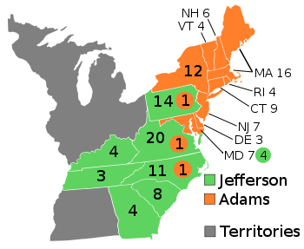
Electoral vote | 71 | 68
States carried | 9 | 7
Popular vote | 35,726 | 31,115
Percentage | 53.4% | 46.6%
Notes:
Image 6.13: Electoral Map 1796
This map of the electoral votes in the presidential election of 1796 shows the regional basis of American politics at that time. The strength of Thomas Jefferson, the Republican candidate, was concentrated in the South and Pennsylvania. John Adams, the Federalist candidate, was strongest in New England, New York, New Jersey, and Delaware.

Slide 3
The XYZ Affair and Quasi-War with France
XYZ Affair – The furor created when Americans learned that three French officials, identified in diplomatic correspondence as “X,” “Y,” and “Z,” demanded a bribe from America’s diplomats as the price of beginning negotiations

Slide 4
The Alien and Sedition Acts
Alien and Sedition Acts – Four laws designed to protect America from the danger of foreign and domestic subversion. The first three, the Alien laws, dealt with immigration and naturalization. The Sedition Act criminalized criticism of the federal government.

Slide 5
The Alien and Sedition Acts
States’ rights – The theory that the Constitution was a compact among the states and that the individual states retained the right to judge when the federal government’s actions were unconstitutional

Slide 6
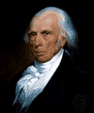
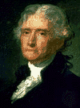
Introducing States’ Rights
Virginia and Kentucky Resolutions
-Madison/Jefferson looked to state legislature for remedy
-Declared acts to be void and of no force
-formulated a states’ rights interpretation of the Constitution

Slide 7
The Disputed Election of 1800
Why did the Federalist political cartoon show Jefferson about to burn the Constitution?

Slide 8
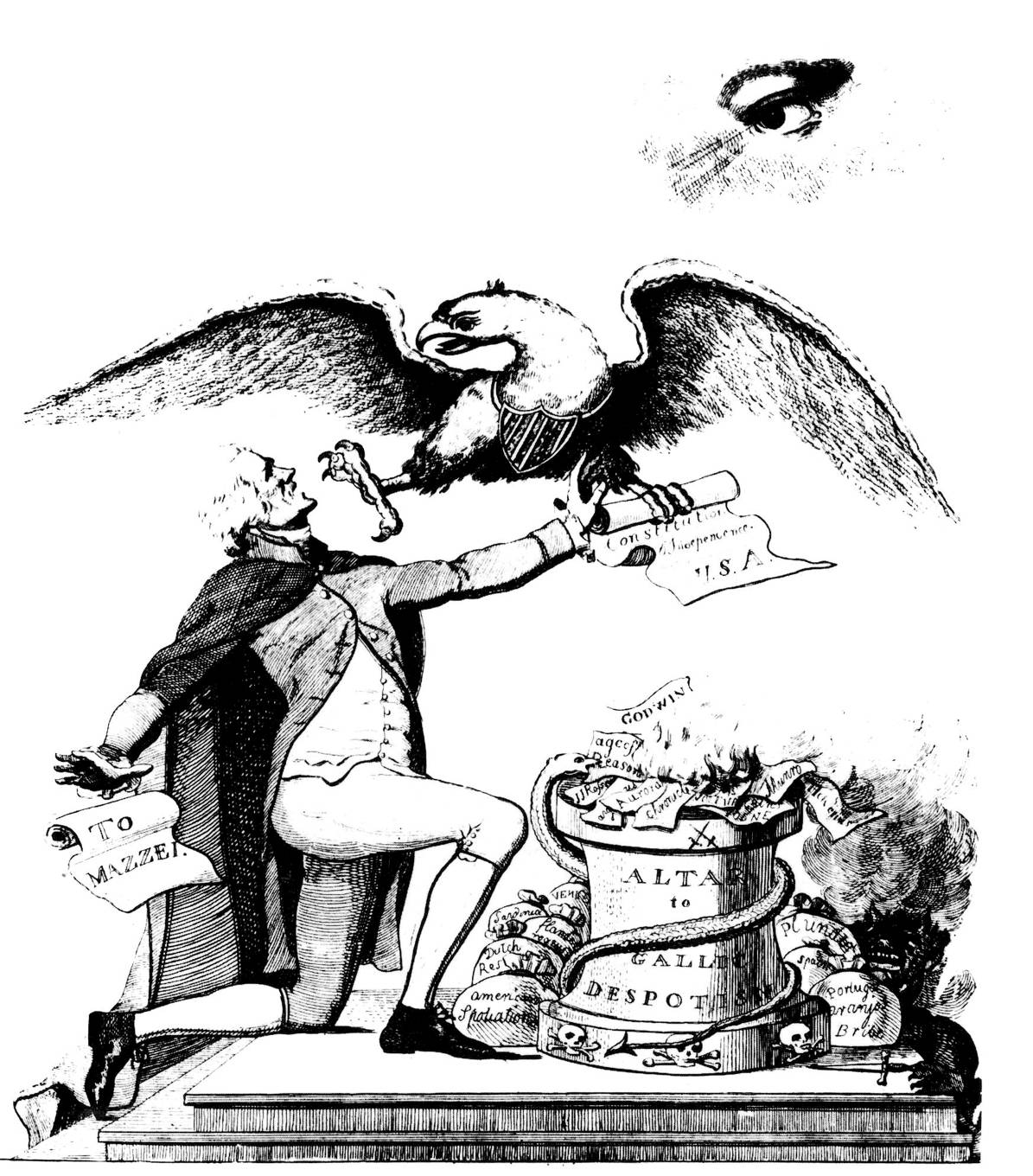
Notes:
Image 6.16: Anti-Jefferson Political Cartoon
Jefferson’s opponents portrayed him as an atheist who drew radical ideas from the French Revolution. In this image the American eagle tries to prevent Jefferson from throwing the Constitution into the flames emanating from the altar of Gallic (French) despotism.

Slide 9
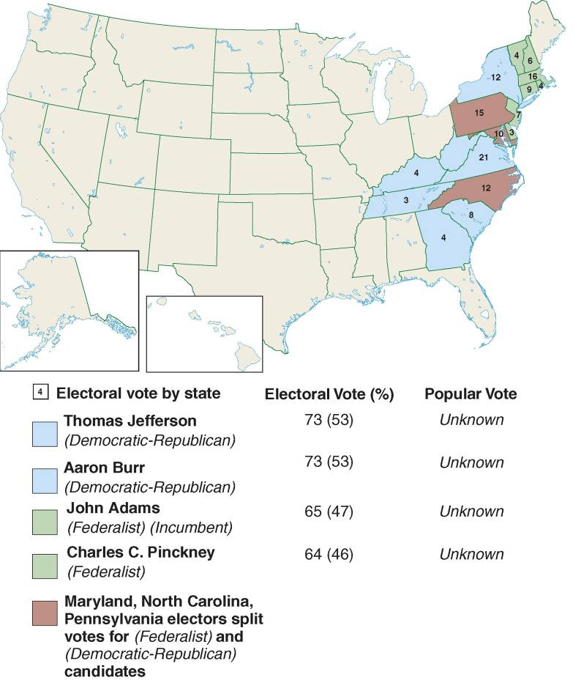
Notes:
Image 6.17: Electoral Map of 1800
Adams’s support in the election of 1800 was concentrated chiefly in New England. Jefferson drew support from the South and the mid-Atlantic.

Slide 10
Political - “Revolution of 1800”
Election of 1800
 | Party | State | Popular Vote | Electoral votes
Jefferson | D-R | VA | 61.4% | 73
Burr | D-R | NY |  | 73
Adams | Fed | Mass | 38.6% | 65
Pinckney | Fed | SC |  | 64
Jay | Fed | NY |  | 1

Slide 11
Political – “Revolution of 1800”
Jefferson and Burr tied with 73 electoral votes
Constitution says House must decide election
Takes 36 ballots
Alexander Hamilton swings key Federalists to vote for Jefferson
Bloodless transfer of power
Governments elected by the people could change in an orderly way
Jefferson, “We are all Democrats, We are all Federalists”
1804 – XII Amendment calling for separate ballots for Pres/V.P.

Slide 12
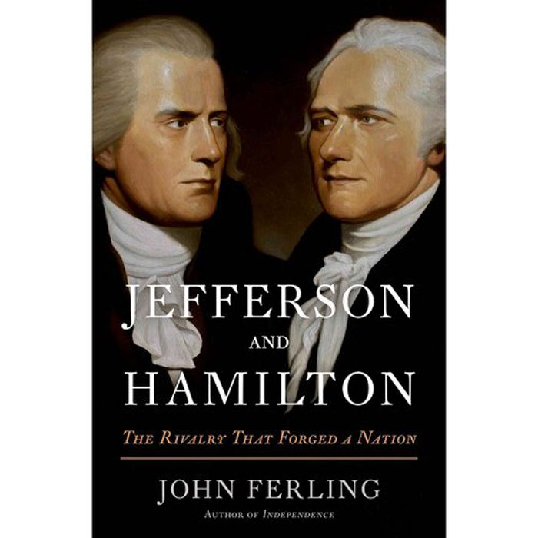
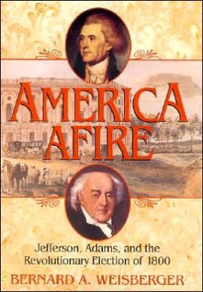
Further Reading
America Afire
Jefferson and Hamilton

Slide 13
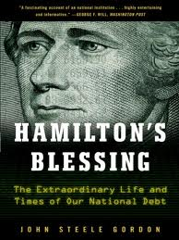
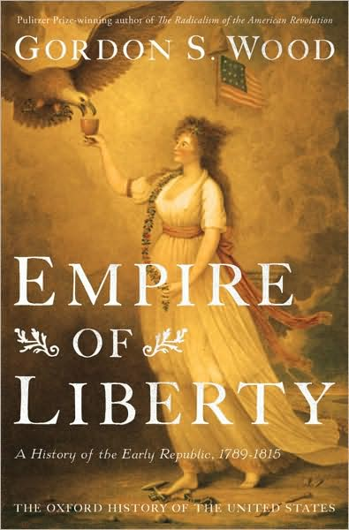
Further Reading
Hamilton’s Blessing
The Empire of Liberty

