Slide 1
Harlem Renaissance
Aim: How did African Americans forge a unique cultural identity during the 1920s and 1930s?

Slide 2
Strange Fruit – Billie Holiday

Slide 3
Reasons for Harlem Renaissance
Shared history
Slavery & institutionalized racism
Segregation & Discrimination
Jim Crow Laws, poll taxes, literacy tests
KKK
Lynching
Great Migration (1916-1940)
Millions of African Americans move from rural South to urban North
Black Pride
New Negro Movement
Marcus Garvey – Universal Negro Improvement Association (UNIA)

Slide 4
Aspirations, Aaron Douglas, 1936

Slide 5
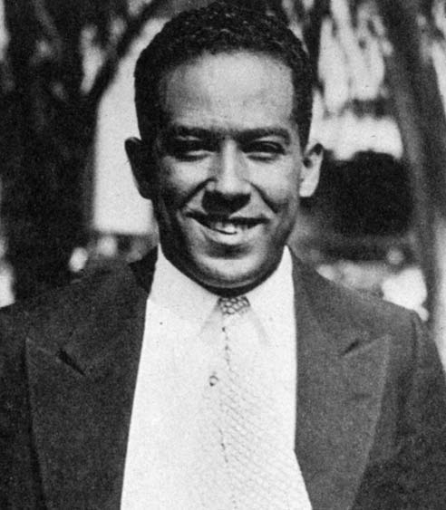
Langston Hughes
“I, Too, Sing America” (1925)
I, too, sing America.
I am the darker brother.
They send me to eat in the kitchen
When company comes,
But I laugh,
And eat well,
And grow strong.
Tomorrow,
I'll be at the table
When company comes.
Nobody'll dare
Say to me,
"Eat in the kitchen,"
Then.
Besides,
They'll see how beautiful I am And be ashamed–
I, too, am America.
Notes:
Langston Hughes

Slide 6
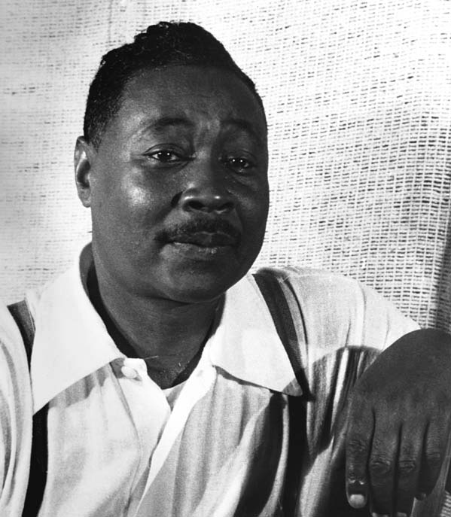
Claude McKay “If We Must Die” (1919)
If we must die, let it not be like hogs Hunted and penned in an inglorious spot, While round us bark the mad and hungry dogs, Making their mock at our accursed lot. If we must die, O let us nobly die, So that our precious blood may not be shed In vain; then even the monsters we defy Shall be constrained to honor us though dead! O kinsmen we must meet the common foe! Though far outnumbered let us show us brave, And for their thousand blows deal one deathblow! What though before us lies the open grave? Like men we'll face the murderous, cowardly pack, Pressed to the wall, dying, but fighting back!
6 Visions of America, A History of the United States

Slide 7
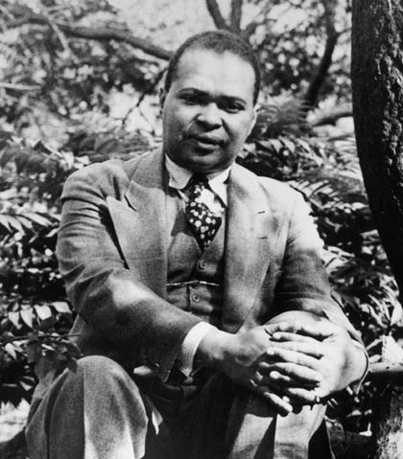
Countee Cullen “Incident” (1924)
Once riding in old Baltimore, Heart-filled, head-filled with glee, I saw a Baltimorean Keep looking straight at me.
Now I was eight and very small, And he was no whit bigger, And so I smiled, but he poked out His tongue, and called me, “Nigger.”
I saw the whole of Baltimore From May until December; Of all the things that happened there That's all that I remember.
7 Visions of America, A History of the United States

Slide 8
Impact of Harlem renaissance
Harlem became center of intellectual thought and a symbol of liberty for African-Americans
Redefined how America viewed the African-American population
New spirit of self-determination provided foundation for Civil Rights Movement
Realization of a unified racial identity, history
Literature appealed mainly to middle-class African Americans and to whites, but inspired generations of black writers

