Slide 1
Culture
College Sociology
Dr. Urban

Slide 2
What is culture?
Culture consists of all the shared products of human groups.
Not only physical objects, but also the set of values, norms, and behaviors shared by a social group.
Material Culture – Physical objects we create, such as jewelry, art, buildings, etc.
Nonmaterial Cultures – Abstract human creations, such as beliefs, family patterns, ideas, language, political and economic systems, rules, skills, and work practices

Slide 3
Society and Culture
Society | Culture
Consists of people A group of interdependent people who have organized in such a way as to share a common culture and feeling of unity. | Consists of the material and nonmaterial products that people create.

Slide 4
An expanded notion of culture
Culture also encapsulates the way of life of a social group.
Ann Swidler (1986) described a cultural “toolkit” from which we can choose the appropriate tools—values, norms, practices—for any social situation.
Key point: culture is learned, not instinctual or inherited.

Slide 5
Components of (Symbolic) Culture
Symbol – something to which people attach meaning and that they use to communicate
Gestures - Using one’s body to convey messages without words
Gestures’ meaning differ among cultures
Can Lead to Misunderstandings

Slide 6
Components of Culture
Technology – rules and skills for using physical objects.
Symbols – Create and communicate our culture through symbols.
Language – organization of written or spoken systems into a standardized system.
Values – Shared beliefs about what is good or bad, right or wrong.
Norms – Shared rules of conduct used to enforce cultural values and tell people how to act in specific situations

Slide 7
Language as Culture
Language – System of symbols that can be put together in an infinite number of ways in order to communicate thought.
Words are symbols to which a culture attaches a meaning/
Primary means of communication b/w people
Provides social or shared past, future, and perspective
Allows complex, shared, goal-directed behavior
Like Gestures, the same sound in one culture is entirely different in another
What’s different about spoken vs. written language?

Slide 8
Emoticons - Mike Jones, Microsoft Programmer
:-)
Smile
;-)
Smile with a wink
:-||
Mad
:-))
Really happy
:-D
Big grin
:-*
A kiss
:' -(
Crying

Slide 9
Values, Norms, and Sanctions
Values - What is desirable in life
Ideals that a society holds above all others (e.g., honesty, honor).
These values are the building blocks of norms, which are basic rules of social conduct.
The standards at which we determine what is good or bad
Norms - Expectations or rules for behavior
“Should Do”
Expectations in our societies
Sanctions - Reaction to following or breaking norms
Positive Sanctions
Negative Sanctions

Slide 10
Folkways and Mores
Folkways - Norms not strictly enforced
Walking on the right side of the sidewalk
Holding a door
Mores - Core Values of society
Taboo – Most extreme more; met with revulsion
Laws – defined and enforced by officials

Slide 11
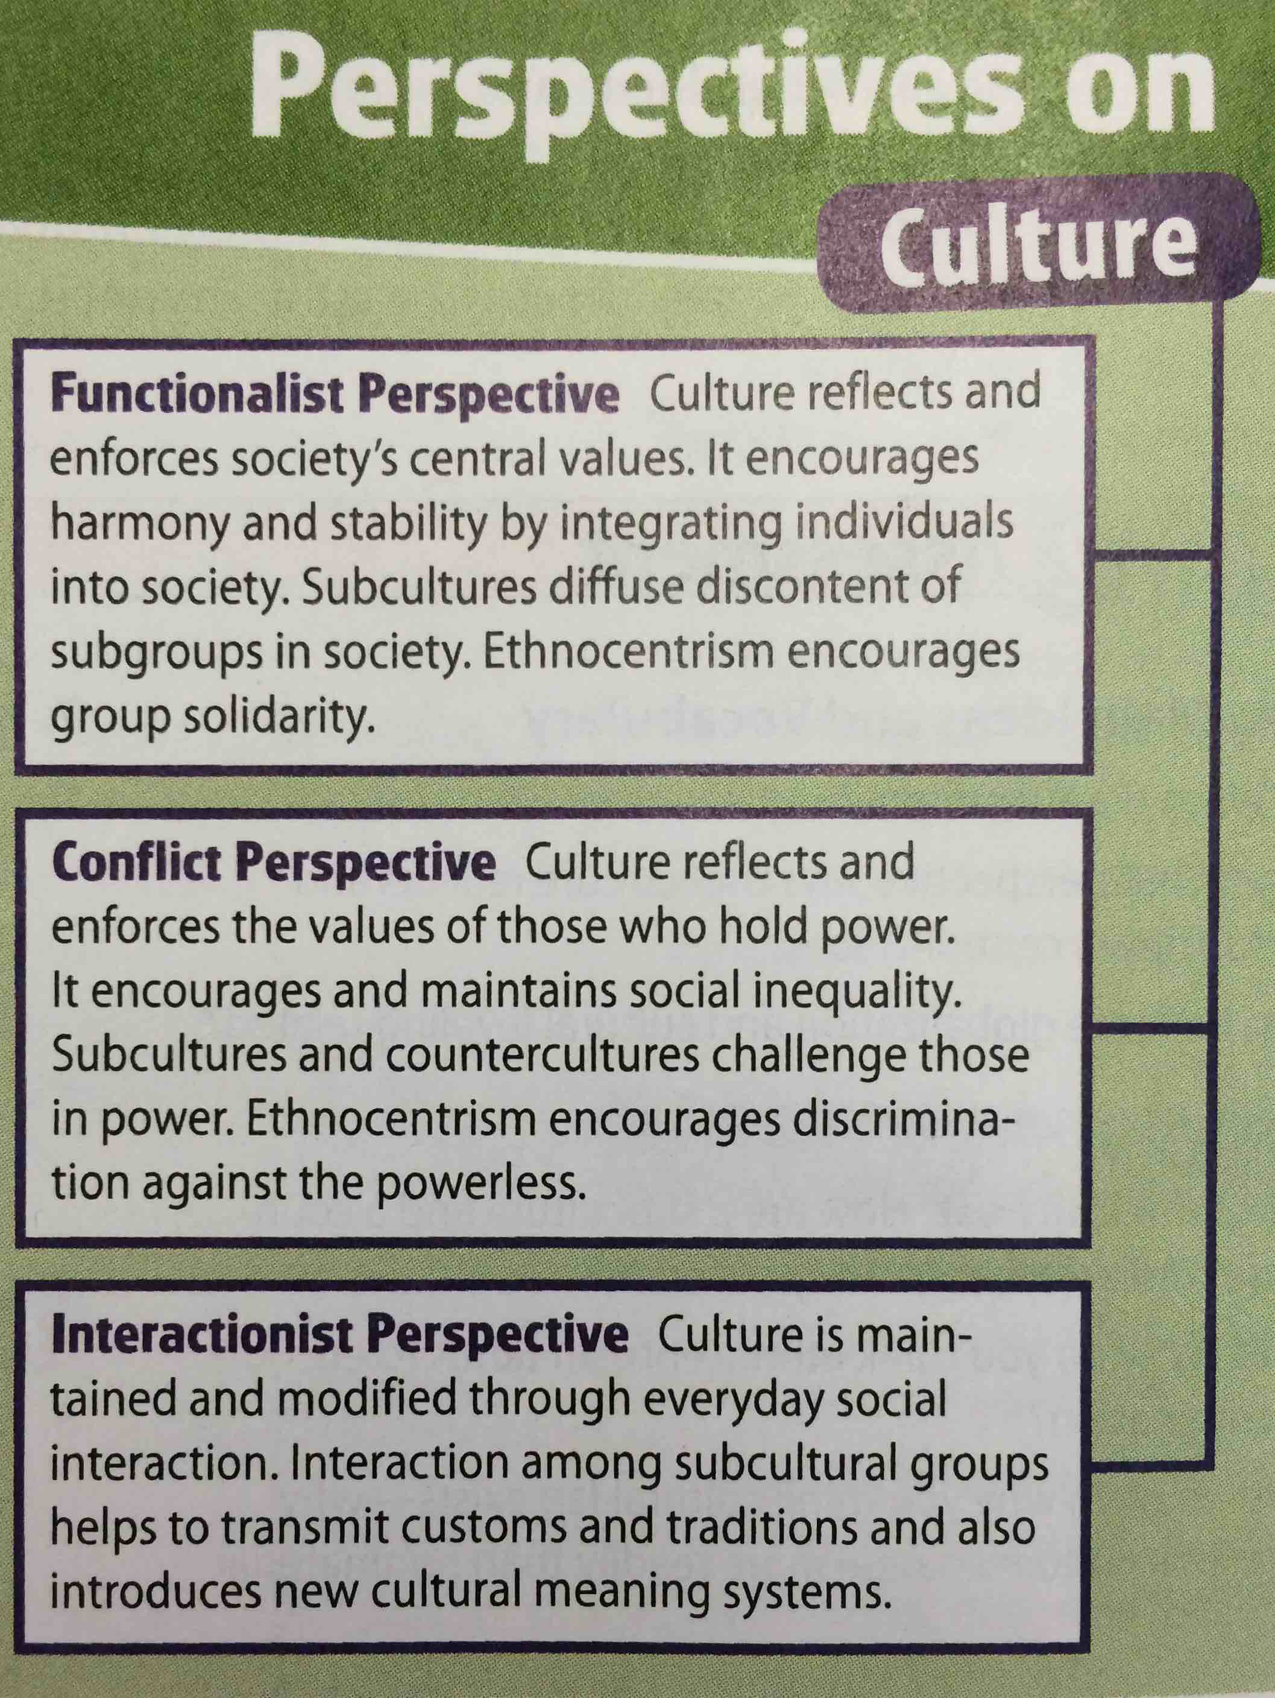

Slide 12
Social Location and Culture
Social Location refers to the groups people belong to because of their place or position in history and society. All people have a social location that is defined by their gender, race, social class, age, ability, religion, sexual orientation, and geographic location.
Read the 2 excerpts and answer the following questions:
Why is the perspective of the writer important in each piece?
How do the writers’ social locations explain certain aspects of human behavior and assumptions about the readings?
What if these readings are taken out of context?
How does the sociological perspective of this 80-year-old Sioux and the German children during WWII take into account social location?
How would you describe your social location? How has it influenced your life? How has it affected your reading of these pieces?

