Slide 1
Causes of Great Depression

Slide 2
What caused the Great Depression?
Consumer spending had actually begun to decline in 1927
Layoffs had begun in 1928 and a clear recession had hit by summer of 1929
Stock market speculation continued despite the slowdown
Stock Market Crash of 1929
10% ? of households owned stock
Margin buying
“Black Thursday” (10/24/29) and “Black Tuesday (10/29/29)
Economists differ on how much weight to place on market crash

Slide 3
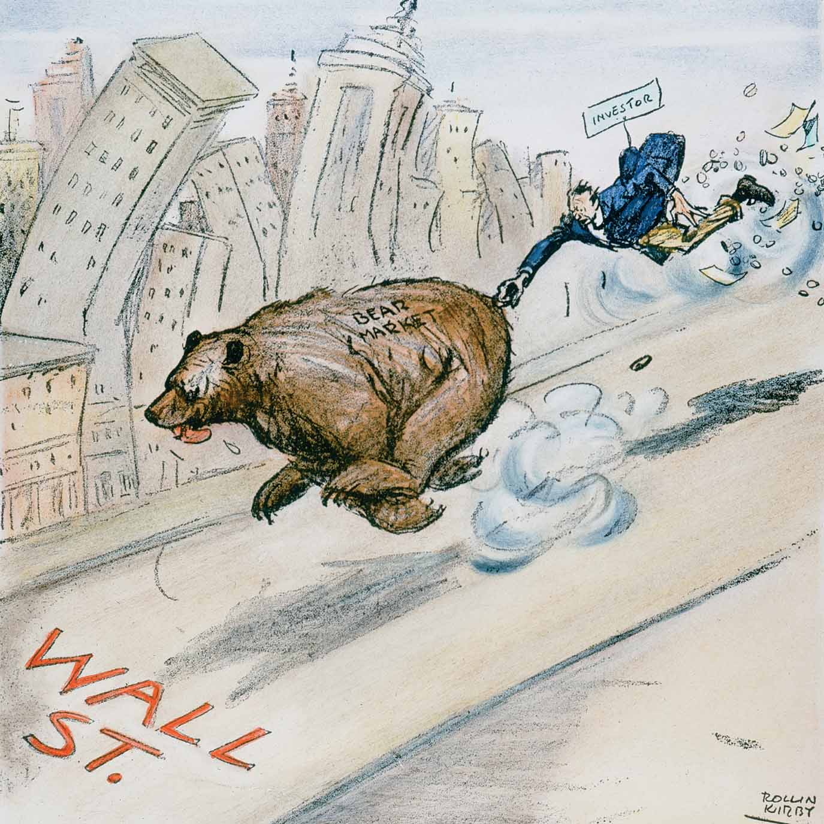
The Stock Market Crash of 1929
Stock Market Crash of 1929 – A ten-day period beginning on October 20, 1929, when the value of stocks plummeted as panicked investors sold off their stock in droves. This moment is usually considered the official start of the Depression.
Notes:
Rollin Kirby’s 1929 cartoon depicts an individual investor losing his money as he clings to a bear running down Wall Street. The bear symbolizes an atmosphere of panic selling and heavy losses, the opposite of a “bull” market in which investor confidence spurs buying and faith in the future.

Slide 4
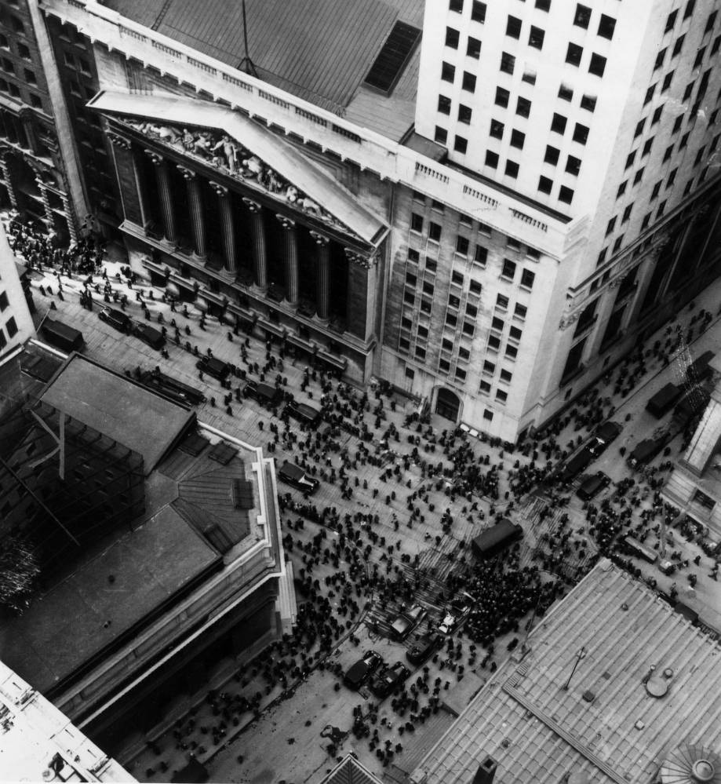
The Bull Market and the Crash
Buyers on margin faced paying hard cash to the cover the loans they received for purchasing stock that sold well below what they had originally paid.
Few people predicted that a depression would follow.
The stock market crash led manufacturers to decrease spending and lay off workers.
Banks, heavily invested in the speculative bubble, began to collapse, intensifying the crisis.

Slide 5
Underlying Weakness of the 1920s Economy
The crash revealed the underlying economic weakness of the economy
Industrial growth during the 1920s had not been accompanied by comparable increases in wages or farm income.
The gap between rich and poor widened, as did that between production and consumption.

Slide 6
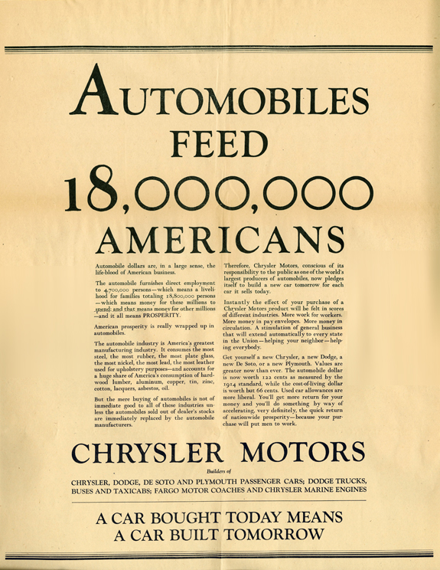
WHY WAS THIS PANIC MORE SEVERE THAN ANY PREVIOUS ECONOMIC DOWNTURN?
Farmers still made up ¼ of economy – their annual salary was 1/3 other industries
Railroad and coal industries also suffered
Structurally, income distribution was unequal
Hoover used the term “depression” instead of “panic” to calm nerves

Slide 7
A Crisis with Credit
Prosperity of the 20’s had hid flaws in banking structure. Lack of regulation.
• 9,000 Bank Failures
– Uninsured deposits
– life savings lost
– Impact on middle-class and elderly
– Fell by 88% between 1929-1932
• 100,000 Businesses failures
• GNP declined from $103.1 billion to $58 billion

Slide 8
Unequal Distribution of Wealth
• Top .1% hold aggregate income equal to the
bottom 42%
Bottom 71% annual incomes below $2500
80% have no savings
This unequal distribution creates fluctuations in spending
Lag in Consumer Power
Expenditures fell by 18% between 1929-1932
• Unemployment– 3.2% in 1929 to 25% by 1933

Slide 9
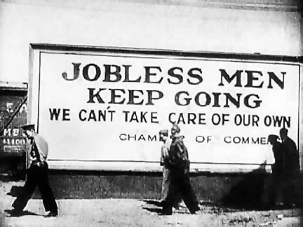
Depression and Gender
Men’s declining status as breadwinners
– Greater impact of depression on “male” industries
– Steel industry, mining, and manufacturing

Slide 10
International Depression
• Dawes Plan (1924)
– Loans to Germany
– reduction in amount of reparations owed to Allies
– purchase U.S. manufactured goods and agricultural products
• European economies collapsed by 1931
– Reduction in demand for U.S. goods
– Inability to repay reparations and loans
• U.S. reduction of foreign investments
• U.S. cutback on purchase of raw materials, supplies, and goods from abroad
• Hawley-Smoot Tariff (1930)
– Raised tariffs to all-time high

Slide 11
Structural Weaknesses
Farmers – ¼ of employed workers
• Low prices
• Over production
• Default on mortgage payments and risk of foreclosures
• Avg. income $273 compared to $750
The Dust Bowl (1930 to 1941)
– Ecological and human-made disasters
– Drought
– Top-soil erosion
– 350,000 relocated West in 1930s

Slide 12
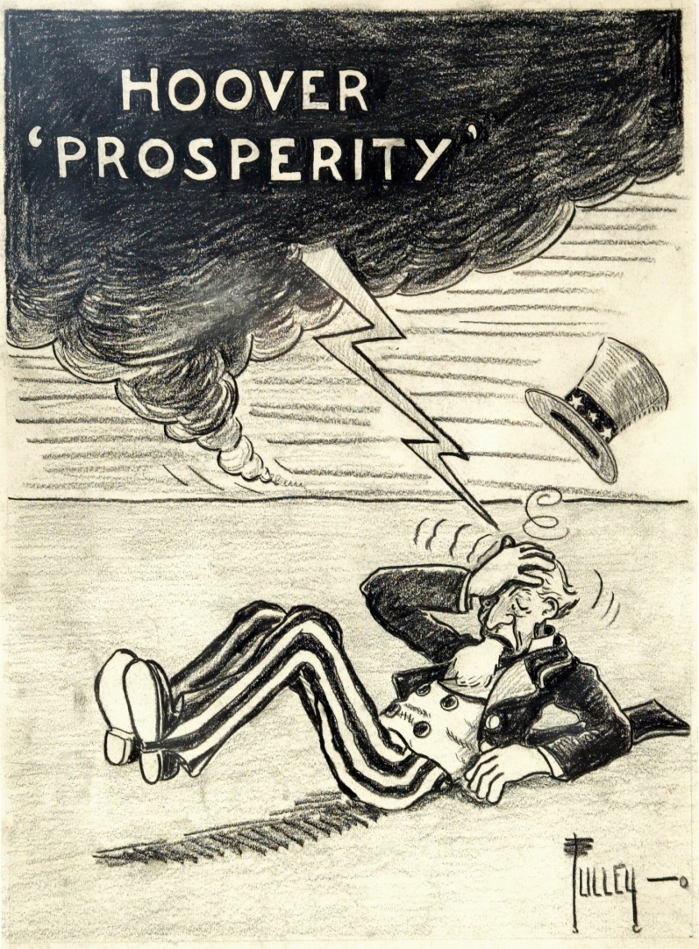
Who’s to Blame?
Bankers, brokers and businessmen received a lot of the blame
Prof. Henretta- “Hoover had responded to the national emergency with government action on an unprecedented scale”
Ultimately Hoover became the scapegoat

