Slide 1
The Articles of Confederation

Slide 2
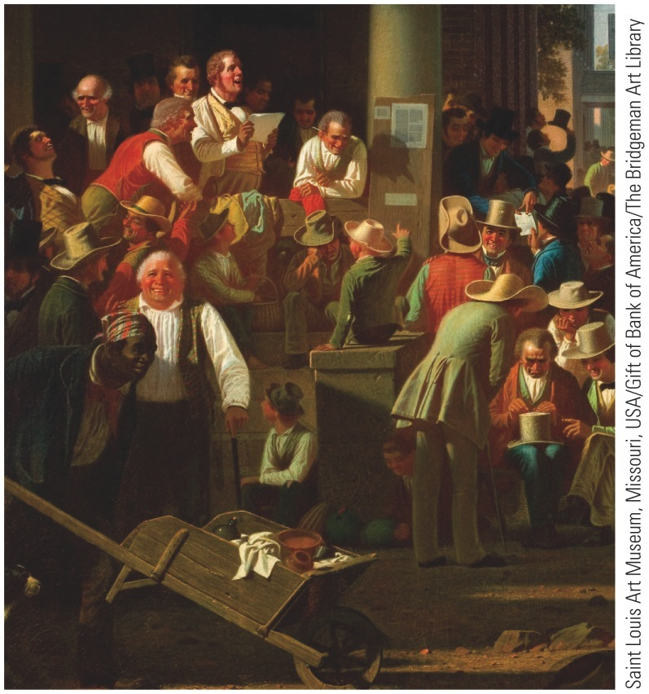
p158
Notes:
The Verdict of the People (detail) This election-day crowd exudes the
exuberant spirit of the era of Andrew Jackson, when the advent of universal
white male suffrage made the United States the modern world's first mass
participatory democracy. Yet the black man with the wheelbarrow, literally
pushing his way into the painting, is a pointed reminder that the curse of
slavery still blighted this happy scene.

Slide 3
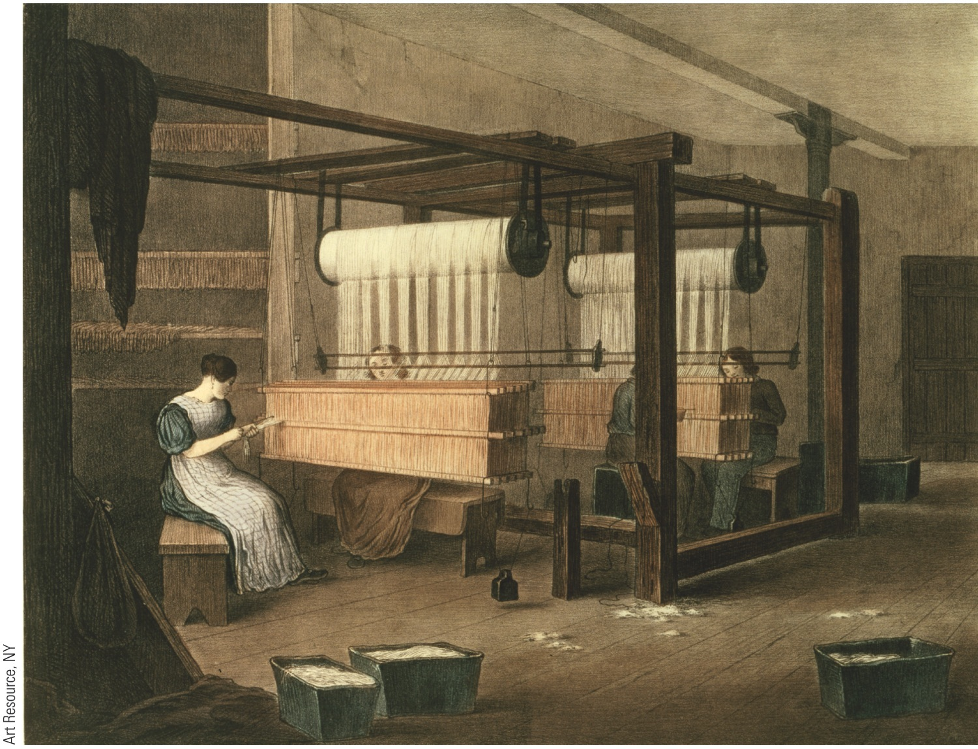
p159
Notes:
Women Weavers at Work
(detail) These simple
cotton looms heralded the
dawn of the Industrial
Revolution, which
transformed the lives of
Americans even more
radically than the events of
1776.

Slide 4
I. A Shaky Start Toward Union
Disruptive forces stalked the land:
Departed Tories left political system inclined toward experimentation and innovation
Economy stumbled post-Revolution
Yet thirteen sovereign states:
Shared similar political structures
Enjoyed rich political inheritance
Were blessed with good political leaders

Slide 5
II. Constitution Making in the States
Constitutional Congress in 1776 called on colonies to draft new state constitutions:
Asked colonies to summon themselves into being as new states
Sovereignty of new states would rest on authority of the people
Connecticut and Rhode Island merely retouched their colonial charters
Others would write new constitutions

Slide 6
II. Constitution Making in the States (cont.)
Massachusetts called for special convention to draft its constitution and then submitted final draft to the people for ratification:
Once adopted, constitution could only be changed by another constitutional convention
Its constitution remained longest-lived constitution in world

Slide 7
II. Constitution Making in the States (cont.)
Common constitutional features:
As written documents, constitutions represented fundamental law, superior to ordinary legislation
Most contained bills of rights— protect prized liberties against legislative encroachment
Most required annual election of legislators
All created weak executive and judicial branches

Slide 8
II. Constitution Making in the States (cont.)
In new governments, legislatures were granted sweeping powers:
Democratic character reflected by presence of many from recently enfranchised western districts
Their influence was demonstrated when some states moved capitals into interior

Slide 9
III. Economic Crosscurrents
Economic changes:
States seized control of former crown lands
Land was cheap and easily available
In America, economic democracy preceded political democracy
Revolution also stimulated manufacturing

Slide 10
III. Economic Crosscurrents (cont.)
Drawbacks of economic independence:
Most British commerce reserved for loyal parts of the empire
American ships now barred from British and British West Indies harbors
Fisheries were disrupted
Americans could freely trade with foreign nations
New commercial outlets (e.g., China in 1784) partially compensated for loss of old ones

Slide 11
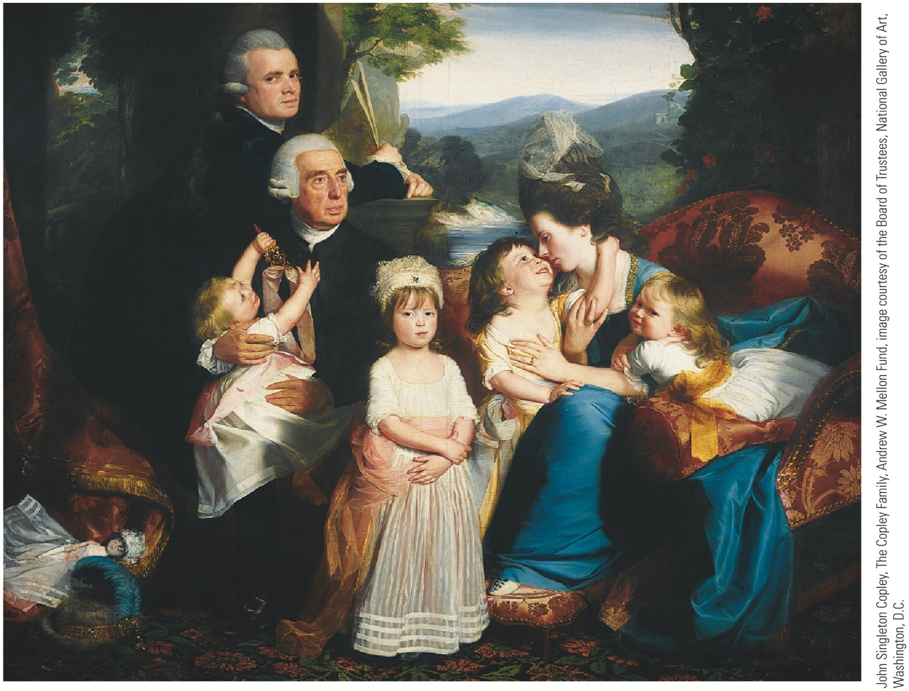
p162

Slide 12
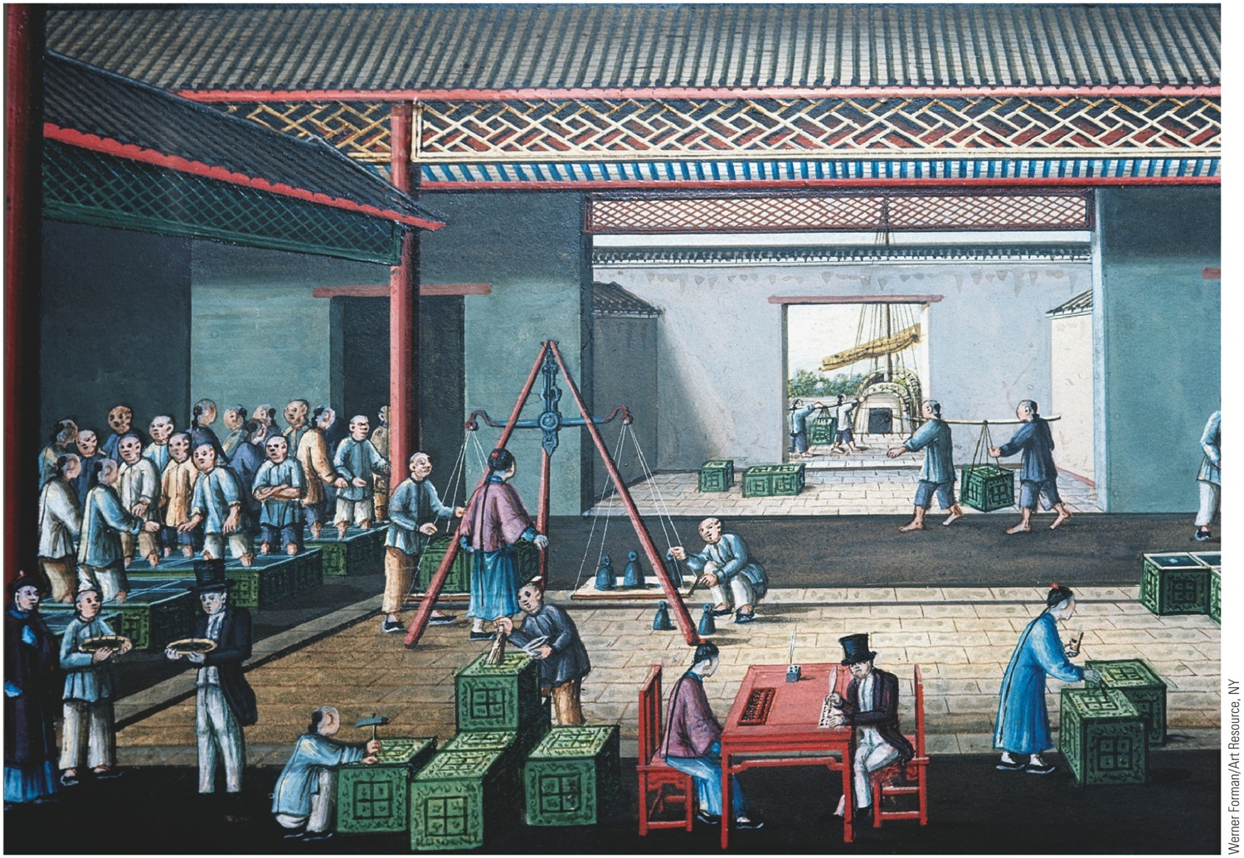
p163
Notes:
Western Merchants Negotiating for Tea in Hong Kong, ca. 1800 Yankee merchants
and shippers figured prominently in the booming trade with China in the late
eighteenth century. Among the American entrepreneurs who prospered in the China
trade was Warren Delano, ancestor of President Franklin Delano Roosevelt.

Slide 13
III. Economic Crosscurrents (cont.)
War spawned demoralizing speculation and profiteering.
State governments borrowed more than they could repay.
Runaway inflation ruined many.
Average citizen was worse off financially at the end of Revolution than at start.

Slide 14
III. Economic Crosscurrents (cont.)
Whole economic and social atmosphere was unhealthy:
A newly rich class of profiteers was conspicuous
Once-wealthy people were destitute
Controversies leading to Revolution had bred:
keen distaste for taxes
encouraged disrespect for laws in general

Slide 15
IV. Creating a Confederation
Second Continental Congress:
Little more than a conference of ambassadors
Was totally without constitutional authority
Asserted some control over military and foreign policy
In all respects, thirteen states were sovereign:
Coined money
Raised armies and navies
Erected tariff barriers

Slide 16
IV. Creating a Confederation (cont.)
Articles of Confederation:
Adopted by Congress in 1777, but not ratified by states until 1781
Chief point of contention was western lands:
6 states had no holdings beyond Allegheny Mtns
7 (esp. New York & Virginia) held huge acreage
Land-rich states could use trans-Allegheny tracts to pay off debts

Slide 17
IV. Creating a Confederation (cont.)
Unanimous approval of Articles by all thirteen states was required:
Maryland held out until March 1781 to get agreement by New York to surrender its western lands
Congress pledged to dispose of these vast areas for “common benefit”
Promised to carve out a number of “republican” states, which overtime would be admitted to union
Pledge redeemed in Northwest Ordinance of 1787 (see Map 9.1).
Disposal of western lands helped encourage union

Slide 18
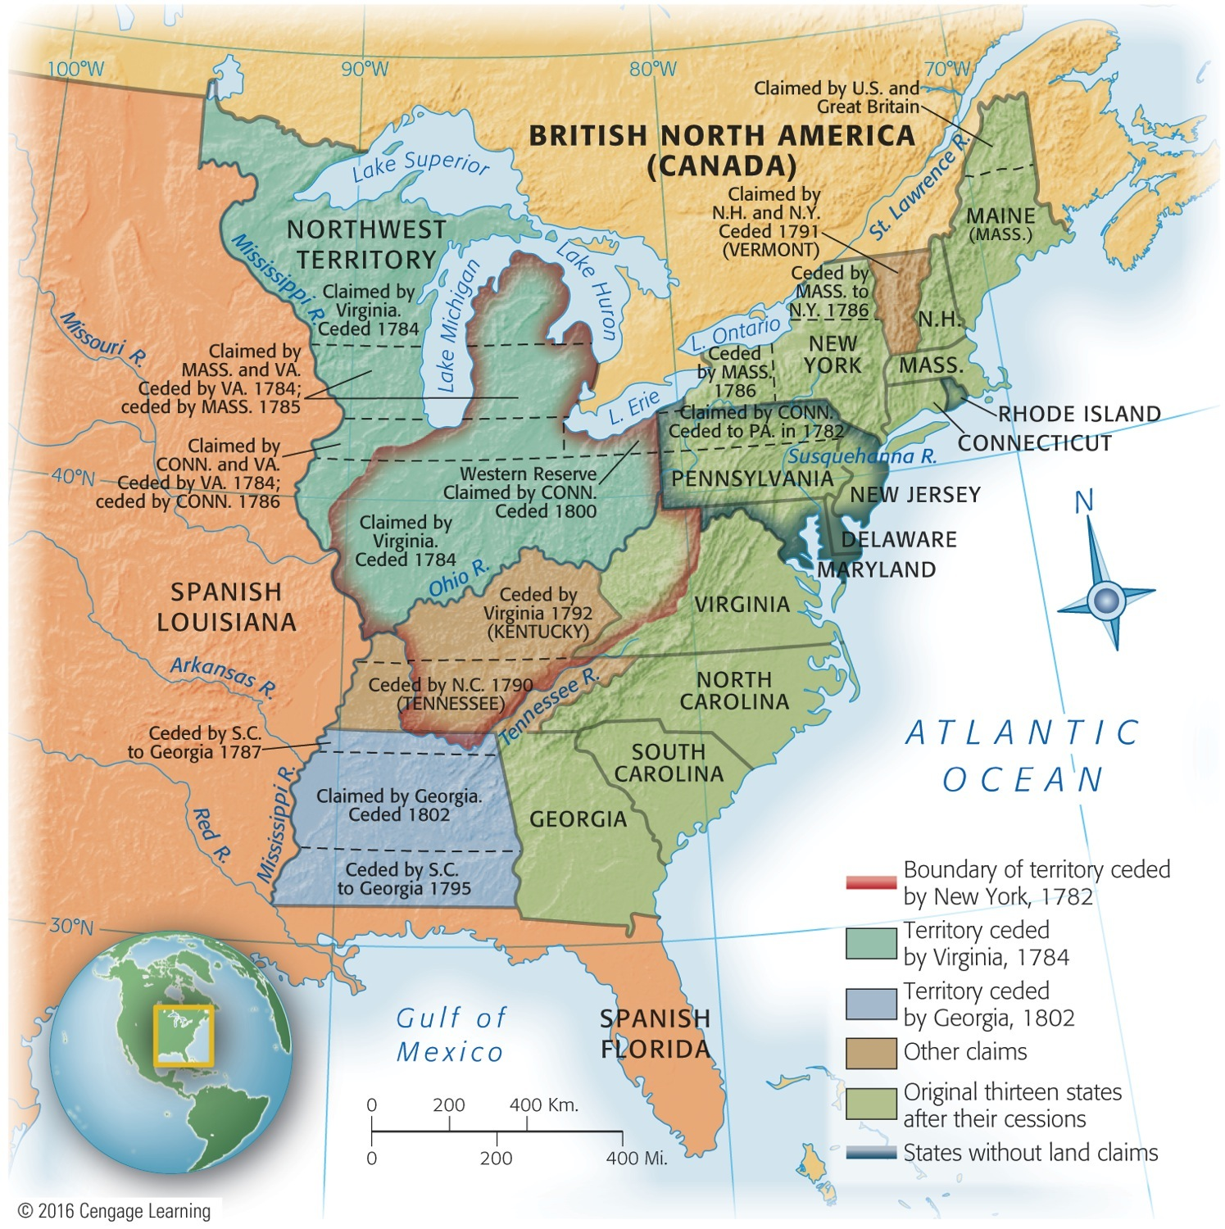
Map 9-1 p164
Notes:
Map 9.1 Western Land Cessions
to the United States, 1782–1802

Slide 19
V. The Articles of Confederation: America's First Constitution
Articles of Confederation:
Provided for loose confederation or “firm league of friendship”
thirteen independent states linked together to deal with common problems, such as foreign affairs
Congress was chief agency
No executive branch
Judicial issues left almost exclusively to states

Slide 20
V. The Articles of Confederation: America's First Constitution (cont.)
Congress, though dominant, was hobbled:
Each state had a single vote
All important bills required support of nine states
Any amendment to Articles required unanimous ratification
Congress was weak—and was purposely designed to be weak

Slide 21
V. The Articles of Confederation: America's First Constitution (cont.)
Two major weakness of Articles:
Congress had no power to regulate commerce
Congress could not enforce its own tax-collection
Congress could advise, advocate, and appeal:
In dealing with states, it could not coerce or control
Nor could it act directly on individuals

Slide 22
V. The Articles of Confederation: America's First Constitution (cont.)
New Congress, with paper power, was less effective than Continental Congress.
Yet, Articles proved to be a landmark:
As first written constitution of Republic, Articles were significant step toward later Constitution
Outlined general powers of national government
Kept alive ideal of union and held states together
Witho Articles, great leap from old Association of 1774 to current Constitution not possible

Slide 23
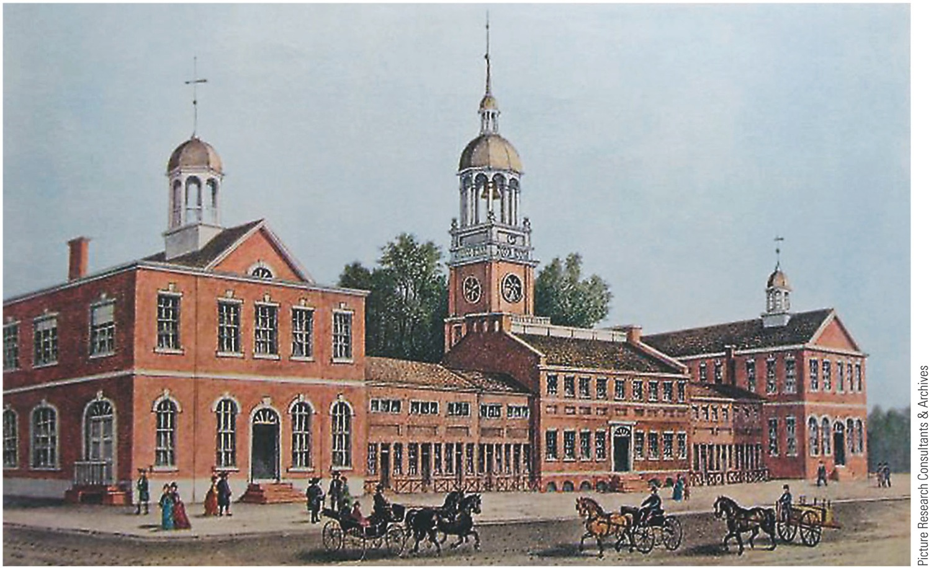
p165
Notes:
Independence Hall, Philadelphia, 1776 Originally built in the 1730s as a meeting place for
the Pennsylvania colonial assembly, this building witnessed much history: here Washington was
given command of the Continental Army, the Declaration of Independence was signed, and the
Constitution was hammered out. The building began to be called “Independence Hall” in the
1820s and is today a major tourist destination in Philadelphia.

Slide 24
VI. Landmarks in Land Laws
Passages of public domain legislation:
Old Northwest = area northwest of Ohio River, east of Mississippi River, south of Great Lakes
Land Ordinance of 1785 (see Map 9.2) set up orderly process to sell land in Old Northwest and use proceeds to pay national debt:
After surveyed, land divided into townships, then into sections
Sixteenth section sold to fund education

Slide 25
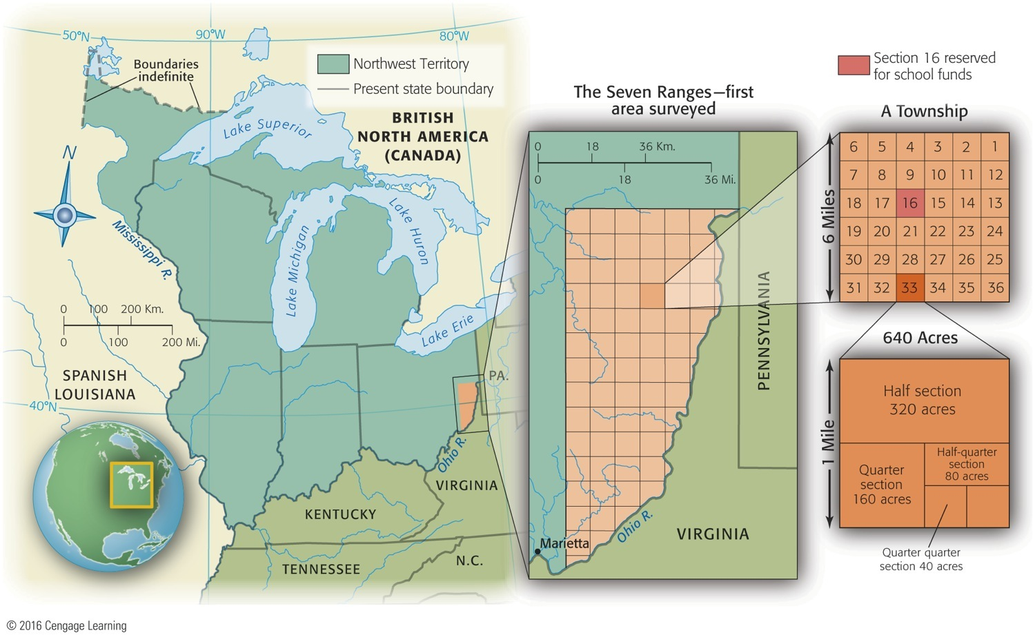
Map 9-2 p166
Notes:
Map 9.2 Surveying the Old Northwest Under the Land Ordinance of 1785 Sections
of a township under the Land Ordinance of 1785.

Slide 26
VI. Landmarks in Land Laws (cont.)
Northwest Ordinance of 1787:
Governance of old Northwest -- how nation would deal with its colonies:
First temporary tutelage, then permanent equality
First, two evolutionary territorial stages under subordination to federal government
Once a territory had 60,000 inhabitants, it could be admitted by Congress as a state
Ordinance forbad slavery in old Northwest

Slide 27
VII. The World's Ugly Duckling
Relations with Britain remained troubled:
England refused to send a minister to America
Declined to negotiate a commercial treaty or to repeal Navigation Laws
Closed West Indies trade to the states
Tried, with help of Allen brothers of Vermont, to annex rebellious area to Canada
Maintained a chain of trading posts on U.S. soil
Continued fur trade with Indians

Slide 28
VII. The World's Ugly Duckling: (cont.)
Spain was openly hostile to new Republic:
Controlled all-important Mississippi River on which pioneers shipped their produce
In 1784 Spain closed river to American commerce threatening West with strangulation
Claimed large areas north of Gulf of Mexico
Schemed with Indians to keep Americans east of Appalachians
Because Spain & Britain influenced Indians, America unable to exercise control over half of its territory (see Map 9.3).

Slide 29
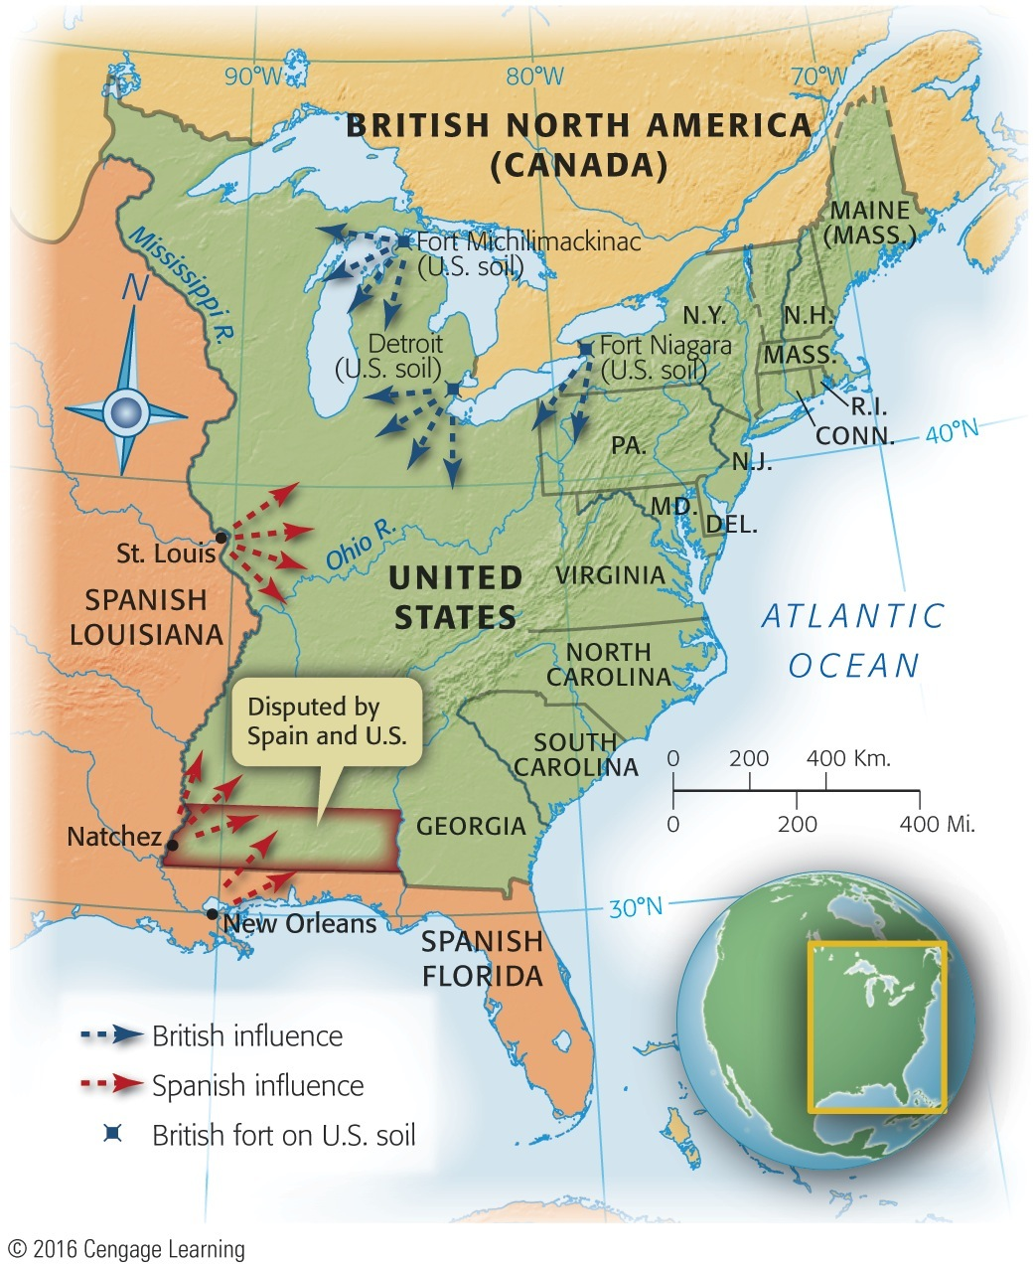
Map 9-3 p167
Notes:
Map 9.3 Main Centers of Spanish and British Influence
After 1783 This map shows graphically that the United
States in 1783 achieved complete independence in name
only, particularly in the area west of the Appalachian Mountains.
Not until twenty years had passed did the new Republic,
with the purchase of Louisiana from France in 1803, eliminate
foreign influence from the east bank of the Mississippi
River. Much of Florida remained in Spanish hands until the
Adams-Oni´s Treaty of 1819 (see p. 239–240).

Slide 30
VII. The World's Ugly Duckling (cont.)
France, America's friend, cooled off now that Britain humbled
North African pirates ravaged America's Mediterranean commence
New nation too weak to fight pirates and too poor to pay bribes.

Slide 31
VII. The Horrid Specter of Anarchy
Economic problems, mid-1780s:
System of raising tax money was breaking down
Interest on public debt was escalating
Some states were levying their own duties
Some were printing depreciated paper money
Shays's Rebellion in western Massachusetts:
Impoverished farmers lost land through mortgage foreclosures and tax delinquencies

Slide 32
VII. The Horrid Specter of Anarchy (cont.)
Led by Captain Daniel Shays, desperate debtors demanded:
State issue paper money, lighten taxes, and suspend property takeovers
Hundreds attempted to enforce demands
Massachusetts authorities responded by raising small army and skirmishes occurred
After 3 Shaysites killed and one wounded, movement collapsed

Slide 33
VII. The Horrid Specter of Anarchy (cont.)
Shays's followers were crushed, but memory remained:
Massachusetts passed debtor-relief laws
Shays's outburst caused fear among propertied class
Civic virtue insufficient to rein in self-interest
Needed stronger central government to block “mobocracy”

Slide 34
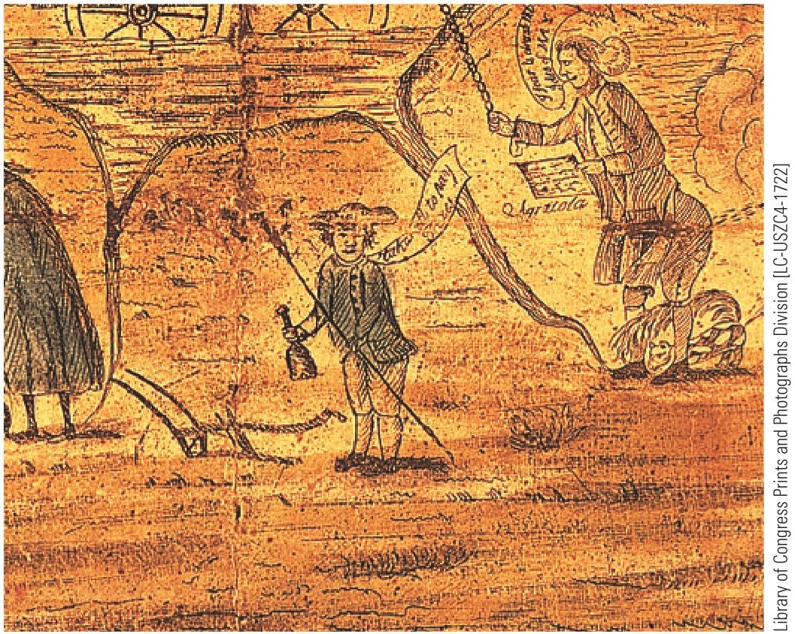
p168
Notes:
Debtors Protest, 1787 This drawing done on the eve of
the writing of the U.S. Constitution features a farmer with a
plow, a rake, and a bottle complaining, “Takes all to pay
taxes.” The discontent of debt-rich and currency-poor
farmers alarmed republican leaders and helped persuade
them that the Articles of Confederation needed to be
replaced with a new constitution.

Slide 35
VII. The Horrid Specter of Anarchy (cont.)
How critical were conditions under Articles?
Conservatives, protecting their wealth, exaggerated seriousness of nation's plight
They sought to amend Articles to create more muscular central government
Both friends and critics of the Confederation agreed it needed strengthening, but disagreed over how much its powers should be increased
Economy actually improved, late 1780s

