Slide 1
Nationalism and US Foreign Policy, 1807-1823

Slide 2
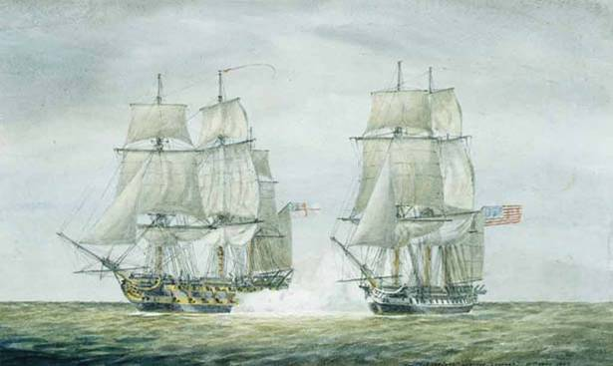
I. Chesapeake-Leopard Affair (1807)
British impressment of American sailors recommences
Forced conscription of sailors by British
Some 6,000 U.S. citizens impressed by Britain (1808 to 1811)
The crew of the Leopard pursued, attacked and boarded the American frigate Chesapeake looking for deserters from the Royal Navy, killing 3 Americans

Slide 3
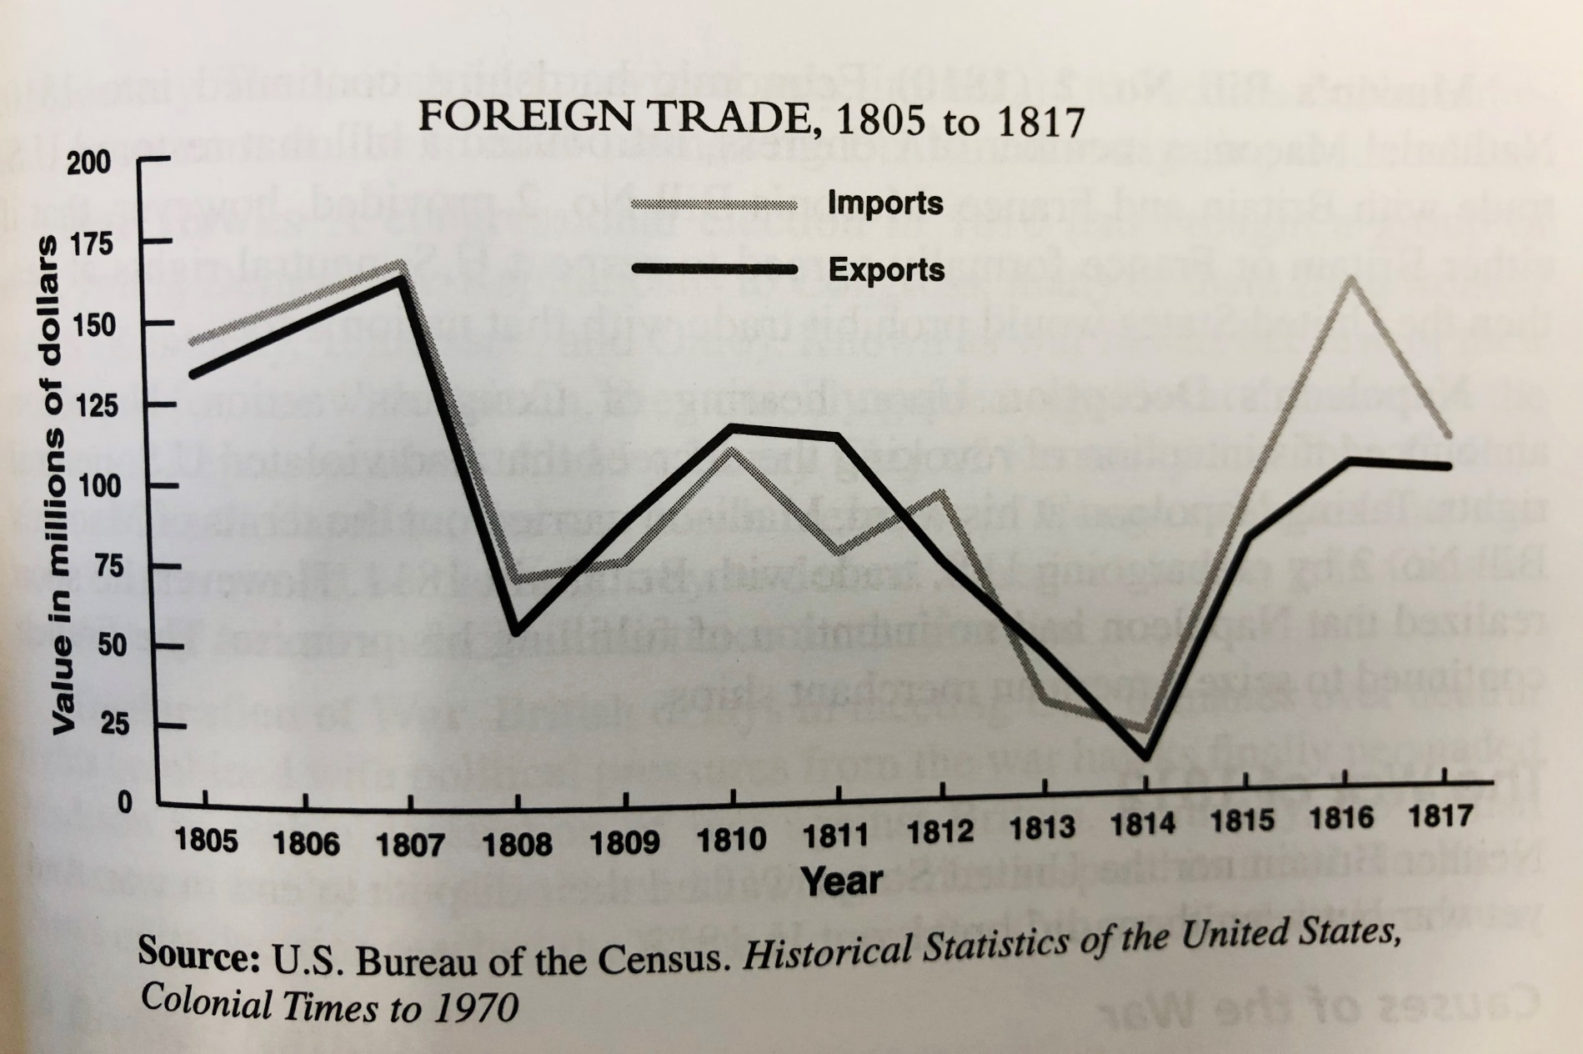
II. Embargo Act

Slide 4
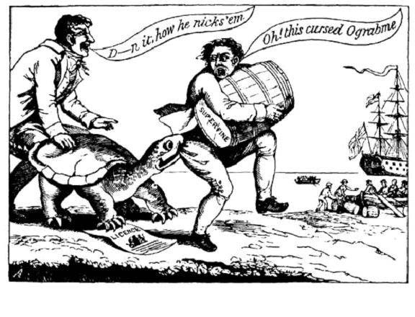
II. Embargo Act, 1807
Prevented US from engaging in foreign trade
Federalists -> ☹
Hurt US economy and Jefferson’s reputation
Non-Intercourse Act – opened up traded with all nations except Britain and France

Slide 5
III. War of 1812 - Causes
British impressment of US sailors
American Embargo
Macon's Bill #2
- America dropped its embargo with France
British supporting/arming Shawnee Confederation
Battle of Tippecanoe
Republican War Hawks in Congress– nationalist/expansionist
Major Issues:
1) Nationalism and land hunger
2) British impressment
3) Indian atrocities
Despite pleas from New England Federalists, Madison asked Congress for a war declaration on June 18, 1812.

Slide 6
Competing Visions
WAR HAWKS AND THEIR CRITICS
War Hawks accused British of arming Native Americans and inciting them to attack American settlers.
Critics argued that conflicts with Native Americans resulted from settlers’ encroachment on their lands.
Why did Westerners believe that the British were encouraging Indian violence against Americans?

Slide 7
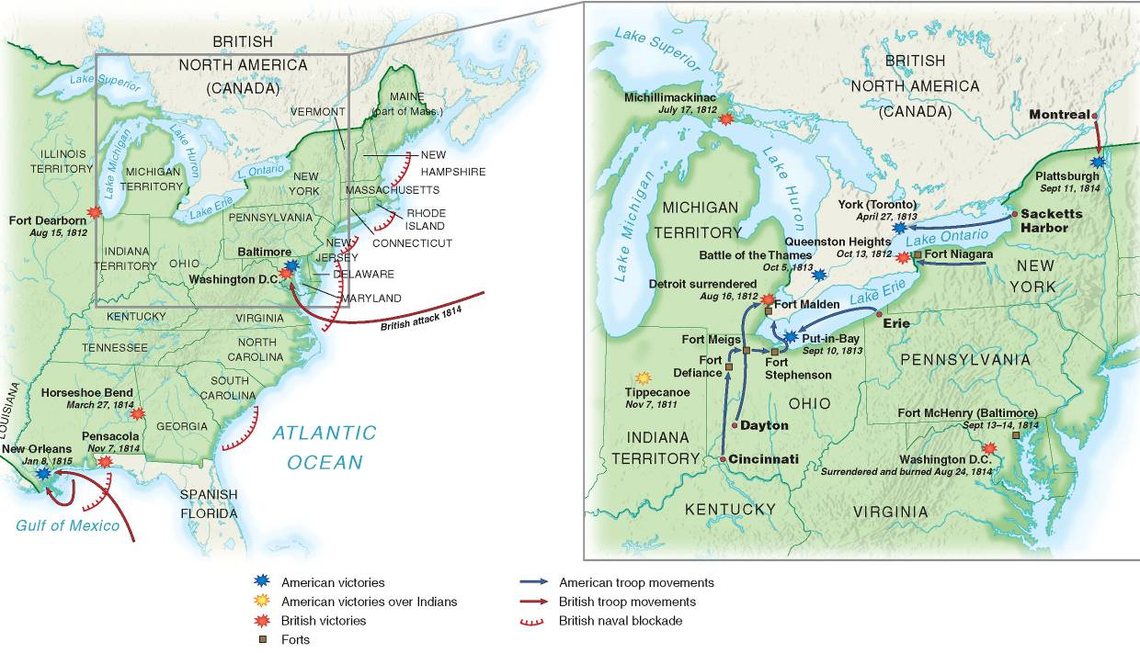

Slide 8
IV. War of 1812
Regular U.S. army ill-trained, ill-disciplined, and scattered
Canada was important battleground because British forces were weakest there
America's offensive strategy failed
Control of Great Lakes was vital
American officer Oliver Hazard Perry's victory on Lake Erie infused new life into American cause

Slide 9
IV. War of 1812
A second British force of 4,000 landed in Chesapeake Bay area in August 1814.
Set buildings on fire, including Capitol & White House.
Americans at Baltimore held firm:
British hammered Fort McHenry, but unable to take city
Francis Scott Key wrote “The Star-Spangled Banner”
American victory in Battle of New Orleans
Andrew Jackson becomes national hero
Treaty of Ghent, signed on Christmas Eve, 1814 was essentially an armistice.

Slide 10
V. Federalist Grievances and the Hartford Convention
New England extremists proposed secession or at least separate peace with Britain @ Hartford Convention
Demands reflected Federalist fears that New England was becoming subservient to South & West
Demanded financial assistance from Washington to compensate for lost trade
Proposed constitutional amendments requiring 2/3 vote in Congress before an embargo could be imposed, new states admitted, or war declared
In light of American victories, Federalists were seen as traitors, and never regained political power

Slide 11
VI. 1812 War - Results
War of 1812 a small war:
6,000 Americans killed or wounded
Globally unimportant, but war had huge consequences for United States:
Other nations developed new respect for America's prowess thanks to Perry & Macdonough
In diplomatic sense, conflict could be called 2nd War for American Independence

Slide 12
VI. 1812 War - Results
Sectionalism increased
Federalists party died (but some ideas were absorbed by Republicans)
War heroes emerged, Jackson and Harrison, and, both later became president.
In economic sense, war bred greater U.S. independence through increased manufacturing.

Slide 13
VII. US & Great Britain after 1812 War
Rush-Bagot Agreement (1817) – limited naval armaments on Great Lakes
Treaty of 1818
Shared fishing rights off Newfoundland
Joint occupation of Oregon Territory for 10 years
US-Canada border in LA Territory at 49th parallel

Slide 14
VIII. Taking Florida
Spain had difficulty governing Florida b/c of revolts in South America
Pres. Monroe commissioned Andrew Jackson to stop border raiders
Jackson attacked Seminoles, drove out Spanish governor, & executed British officers
Spain feared it would lose Florida, so it agreed to sell it to US in 1819 (Florida Purchase Treaty/Adams-Onis Treaty)

Slide 15
IX. Monroe Doctrine, 1823
Reaffirmed American neutrality
U.S. wouldn’t interfere with existing colonies in Western Hemisphere but wouldn’t permit further colonization
Any attempt by a European nation to colonize any area of the Western Hemisphere would be perceived as an act of aggression against the United States
It upset Britain (which wanted to issue a statement jointly) and European Monarchs, but it had little immediate impact—much more important in later US foreign policy toward Latin America.

