Slide 1
The Conservative Ascendancy
Cynicism and Optimism in Post-Watergate America

Slide 2
I. Nixon’s Legacy
A. New Federalism : Give states more control over the use of federal aid
- Nixon wanted to scale back New Deal and Great Society programs
B. “Southern Strategy” – wooed southern voters away from Democratic party
C. Détente: an ease or a relaxation in tensions between the U.S. and USSR (arms limitation, relative security, etc.)
D. Watergate – Cynicism and Distrust toward government; new campaign finance regulations

Slide 3
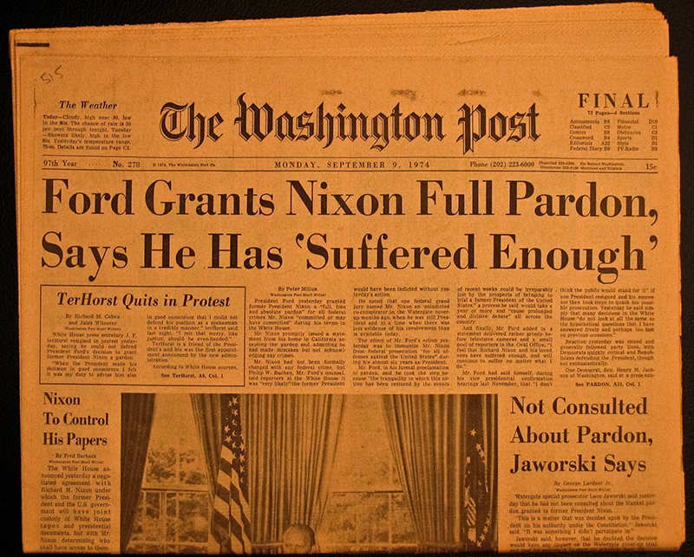
II. Ford Presidency
Nixon’s Pardon- “end the national nightmare”?
Others Jailed
Public distrust of
government

Slide 4
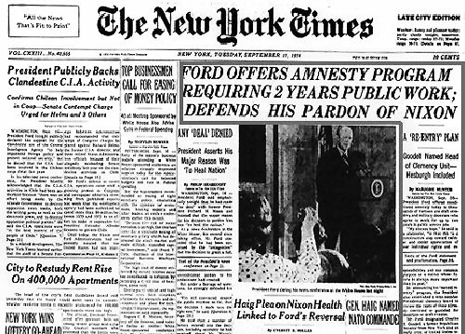
B. Amnesty Plan
1. Ford pardons “draft dodgers” for 2 years’ public work

Slide 5
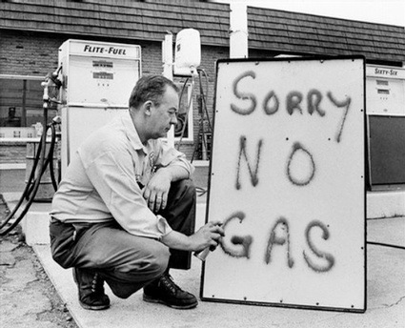
C. INFLATION: OPEC Oil Embargo 1973
Reason: for our support of Israel
Prices of gas and oil doubled
Rationing of gas and federal incentives help ease shortages
Inflation topped 10% - worst recession since WWII
Stagflation – high unemployment coupled w/ high inflation.

Slide 6
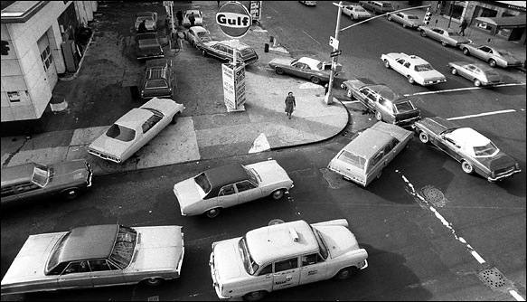

Slide 7
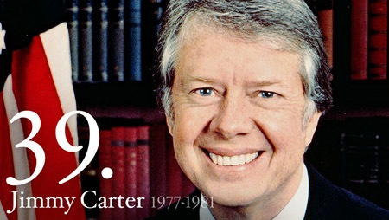
III. Presidency of Jimmy Carter
From Plains, Georgia
Peanut Farmer
Baptist upbringing
“Competent and compassionate Government”
Governor of Georgia
Washington “outsider”

Slide 8
B. Carter’s Achievements
Helsinki Accords: human rights
Camp David Accords, 1977: Peace treaty b/w Israel and Egypt
Panama Canal Treaties, 1977: turn canal over to Panama

Slide 9
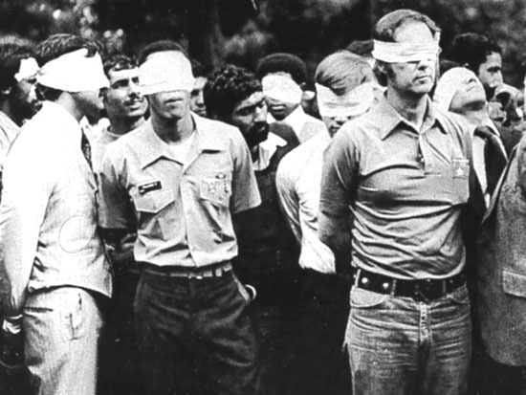
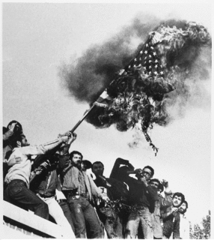
C. Carter’s Failures

Slide 10
Iranian Hostage Crisis
1. Revolution led by Islamic Fundamentalist toppled pro-American Shah Reza Pahlavi.
2. Shah receives cancer treatment in U.S.
3. Revolutionaries take U.S. embassy hostage for 444 days

Slide 11
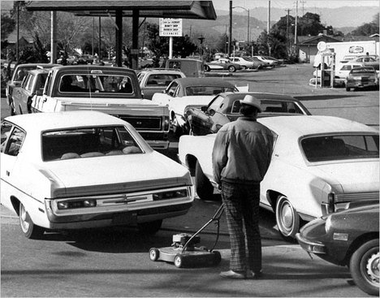
Boycott of 1980 Olympics: USSR invades Afghanistan
Economic Crisis: Stagflation
High inflation, slow economic growth, rising unemployment
Continued Energy Problems: OPEC boycott

Slide 12
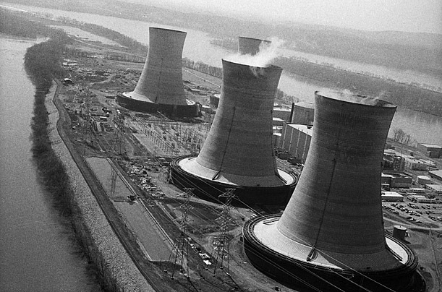
Nuclear Accident: 3 Mile Island

Slide 13
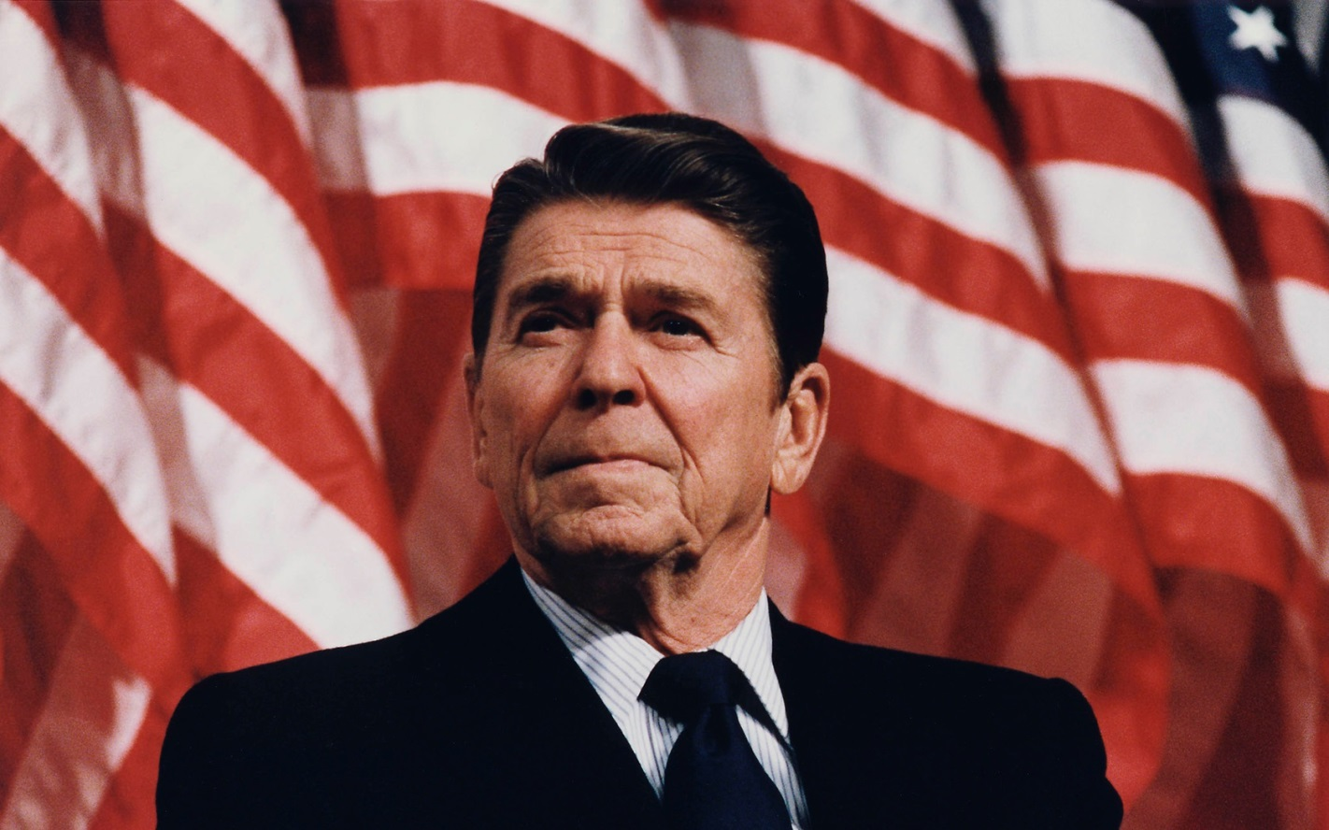
IV. President Ronald Reagan
“Government is not the solution to our problems. Government is the problem.”

Slide 14
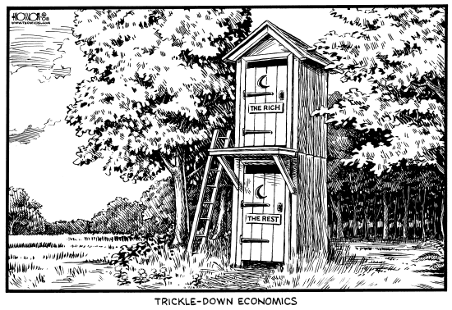
A. Reagan’s Domestic Policies
Reaganomics: Supply-side, Trickle-down Economics
Cut taxes of wealthy
Reinvest in business
- Deregulation

Slide 15
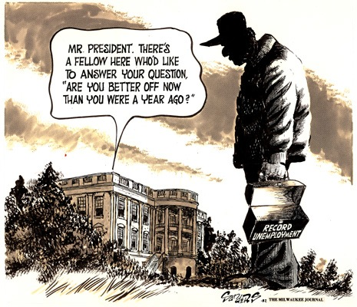

Slide 16
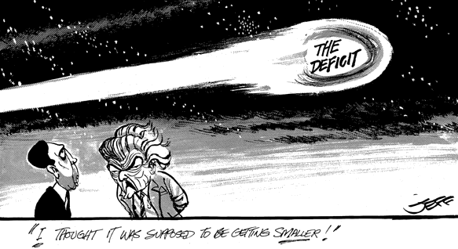
B. Balanced Budget?
Reduced social welfare programs
- Cut welfare, Medicaid, etc.
Cuts to EPA
Increased spending on defense & military:
“STAR WARS” (SDI)
Result: National Debt Rises

Slide 17
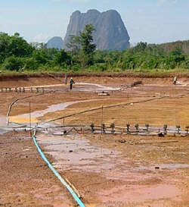
C. Farm Aid
World Wide Recession
Gov’t provides subsidies to help farmers
Deficit grows

Slide 18
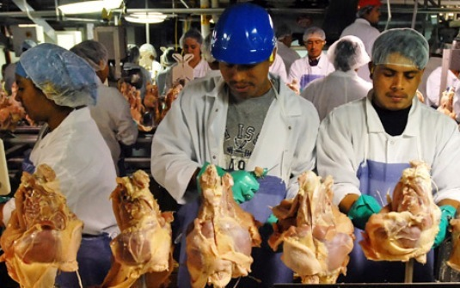
D. Immigration
- Immigration Reform and Control Act (1986) - Forbade employers from hiring illegal immigrants, but offered amnesty for many illegal immigrants

Slide 19
Reagan’s Foreign Policy
Questioning Détente?
B. Central America (Reagan Doctrine)
1. El Salvador: Sent $ and advisers help back anti-communist forces
2. Nicaragua – U.S. supports Contras fighting Cuban backed Sandinistas (unknown to Congress)
a. Congress cuts off aid
C. Covert CIA actions support pro-U.S. governments and fight left-leaning gov’ts

Slide 20
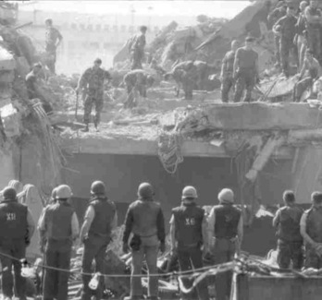
C. Middle East
Rise of terrorism in 1980’s to promote political and Islamist (fundamentalist) causes
Lebanon: 1983 U.S. marines killed by bomb laden truck into their barracks

Slide 21
Reagan’s Second Term 1985-1989
Economics
1. Uneven distribution of wealth
2. Tax cuts for 60% of Americans
3. Favor the Rich

Slide 22
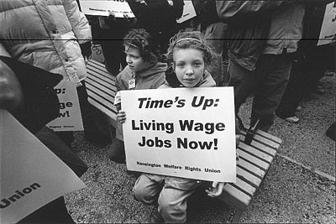
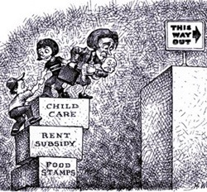
4. Cut federal programs

Slide 23
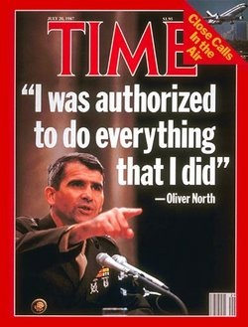
B. Iran Contra Affair
Sold weapons to Iran in exchange for Iranian help to release hostages in Lebanon
$ from sale given to Contras to fight leftist Sandinistas in Nicaragua
Congressional committee cleared Reagan
Col. Oliver North and CIA operatives found guilty

Slide 24
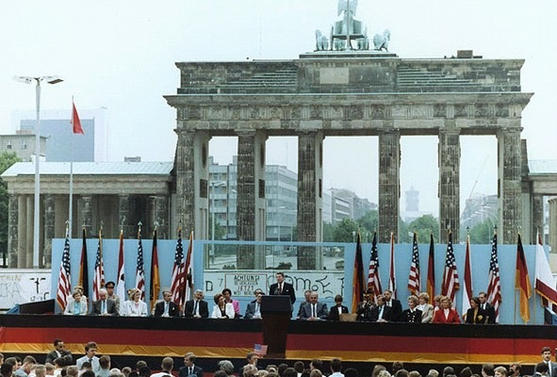
C. Glasnost and Perestroika
Tough stand against communism and increased defense measures forced Soviets to raise its on military spending
“Mr. Gorbochev, tear down this wall!”
Gorbochev pursued policies of Glasnost and Perestroika to encourage political and economic reform in Soviet Union.

Slide 25
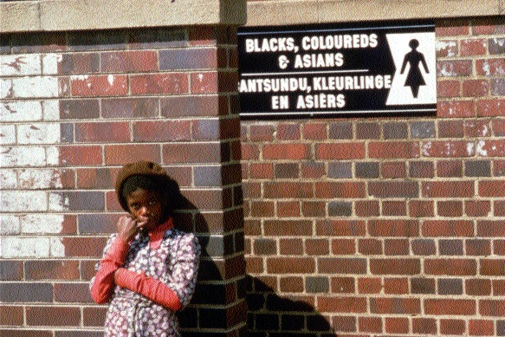
D. Apartheid in South Africa
1. Strict economic sanctions until apartheid ended.

Slide 26
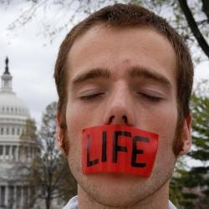
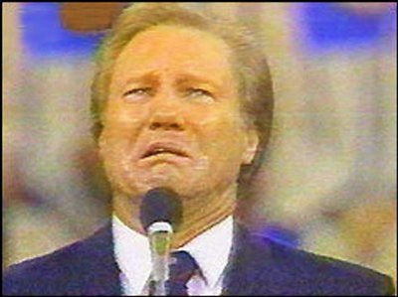
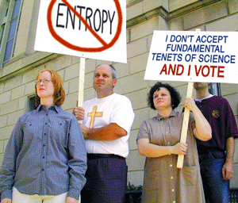
E. Rise of the Christian Right
Individuals like Jerry Falwell and Pat Robertson, along with groups such as Moral Majority, push Republicans to pander to Christian fundamentalists, who became an important and essential conservative constituency.

Slide 27
Trends in Government 1960-1980
Welfare:
Cold War:
Size of Government:
Tax Burden:
President Ronald Reagan 1981-1989
Limit Welfare programs: stress self-reliance
Confrontation with communism to end Cold War
Reduce government size and power
Reduce tax burden for the wealthy by cutting taxes

Slide 28
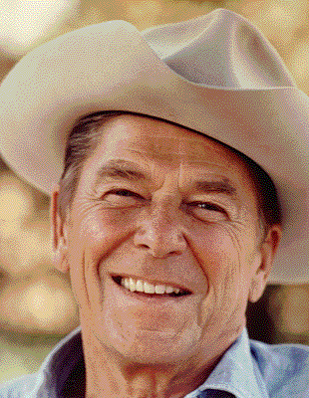
“A Conservative Revolution?”

Slide 29
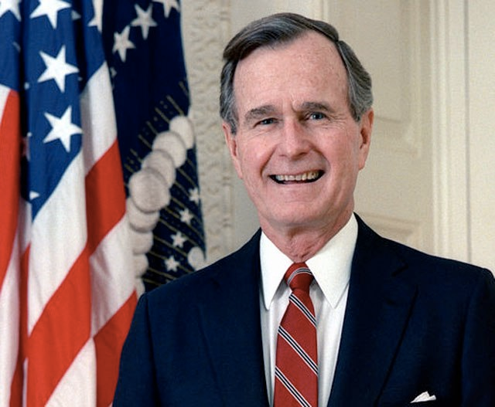
George H. W. Bush (1989-1993)

Slide 30
Foreign Policy
Collapse of Soviet Union & End of Cold War
Fall of Berlin Wall
Invasion of Panama and ouster of Manuel Noriega
Persian Gulf War
Iraq invaded Kuwait
Operation Desert Shield/Storm – bombing campaign against Iraq, followed by ground troops in Kuwait to defeat Saddam Hussein.

Slide 31
Domestic Issues
Americans with Disabilities Act – outlaws discrimination against people with disabilities and requires reasonable accommodations be made for them.
Economic slump
Forced to raise taxes, violating a campaign slogan (“Read my lips: no new taxes.”)

Slide 32
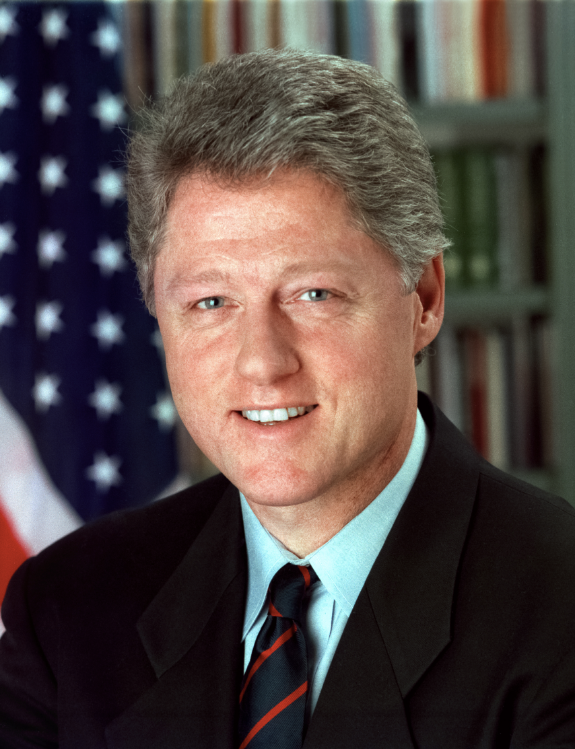
Bill Clinton (1993-2001)

Slide 33
“New Democrat” – More moderate
Failed health care overhaul
Oversaw period of economic growth and tech innovation
Midterm Elections - Conservative Backlash, “New Right” – cut taxes, scale back welfare
Newt Gingrich’s “Contract with America”
Balance Budget and Surplus
Terrorism - Oklahoma City, WTC, ’96 Olympics, USS Cole
Foreign Policy - Somalia; Genocide in Rwanda; Bosnia & Kosovo (Ethnic Cleansing); Nuclear proliferation
Globalization – NAFTA; WTO protests
Impeachment - affair, perjury, and acquittal; Partisanship intensifies

Slide 34
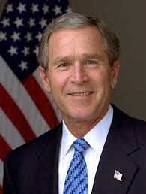
George W. Bush (2001-2009)

Slide 35
2000 Election – closest since 1876; recount in Florida halted by Supreme Court in Bush v. Gore
Bush Tax Cuts – cuts across all income levels, but benefitted wealthiest and contributed to budget deficits
No Child Left Behind – education reform, testing
9/11 – Al Qaeda – radical Islamic fundamentalists
War on Terror; War in Afghanistan; War in Iraq
Patriot Act – gave gov’t brad surveillance powers; limited civil liberties. Dept. of Homeland Security
The Great Recession – worst since Great Depression; housing bubble burst; credit & financial sector crisis; Wall Street bailouts (TARP stimulus)

Slide 36
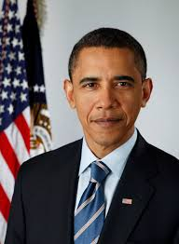
Barack Obama (2009- )

Slide 37
American Recovery and Reinvestment Act - $787 Billion economic stimulus during Great Recession – tax cuts, $ for construction, education, etc.
Affordable Care Act (Obamacare) – Extended healthcare through combination of subsidies, mandates, and insurance exchanges. Opposed by conservatives.
Rise of Tea Party – Right-wing activists (conservatives and libertarians) supporting limited government, low taxes, and socially conservative causes (gun rights, “family values,” etc.)
Foreign Policy – drone warfare; drawing down wars in Iraq and Afghanistan; killing Osama bin Laden; Arab Spring; ISIS.

Slide 38
Contemporary Issues
Graying of America
Budget Deficits and National Debt
Immigration reform
Gay rights and same-sex marriage
Campaign finance
Gun Violence
Climate Change
Health Care
Income/Wealth Gap
Partisanship → Gridlock
Tech boom
Privacy/Surveillance
Sunbelt Migration
Racism
“Culture Wars”
Entitlement reform
Social Security, Medicare

